Slide 1
The helen keller experience
MD 34
PCC Ron Seybold
January 29, 2025

Slide 2
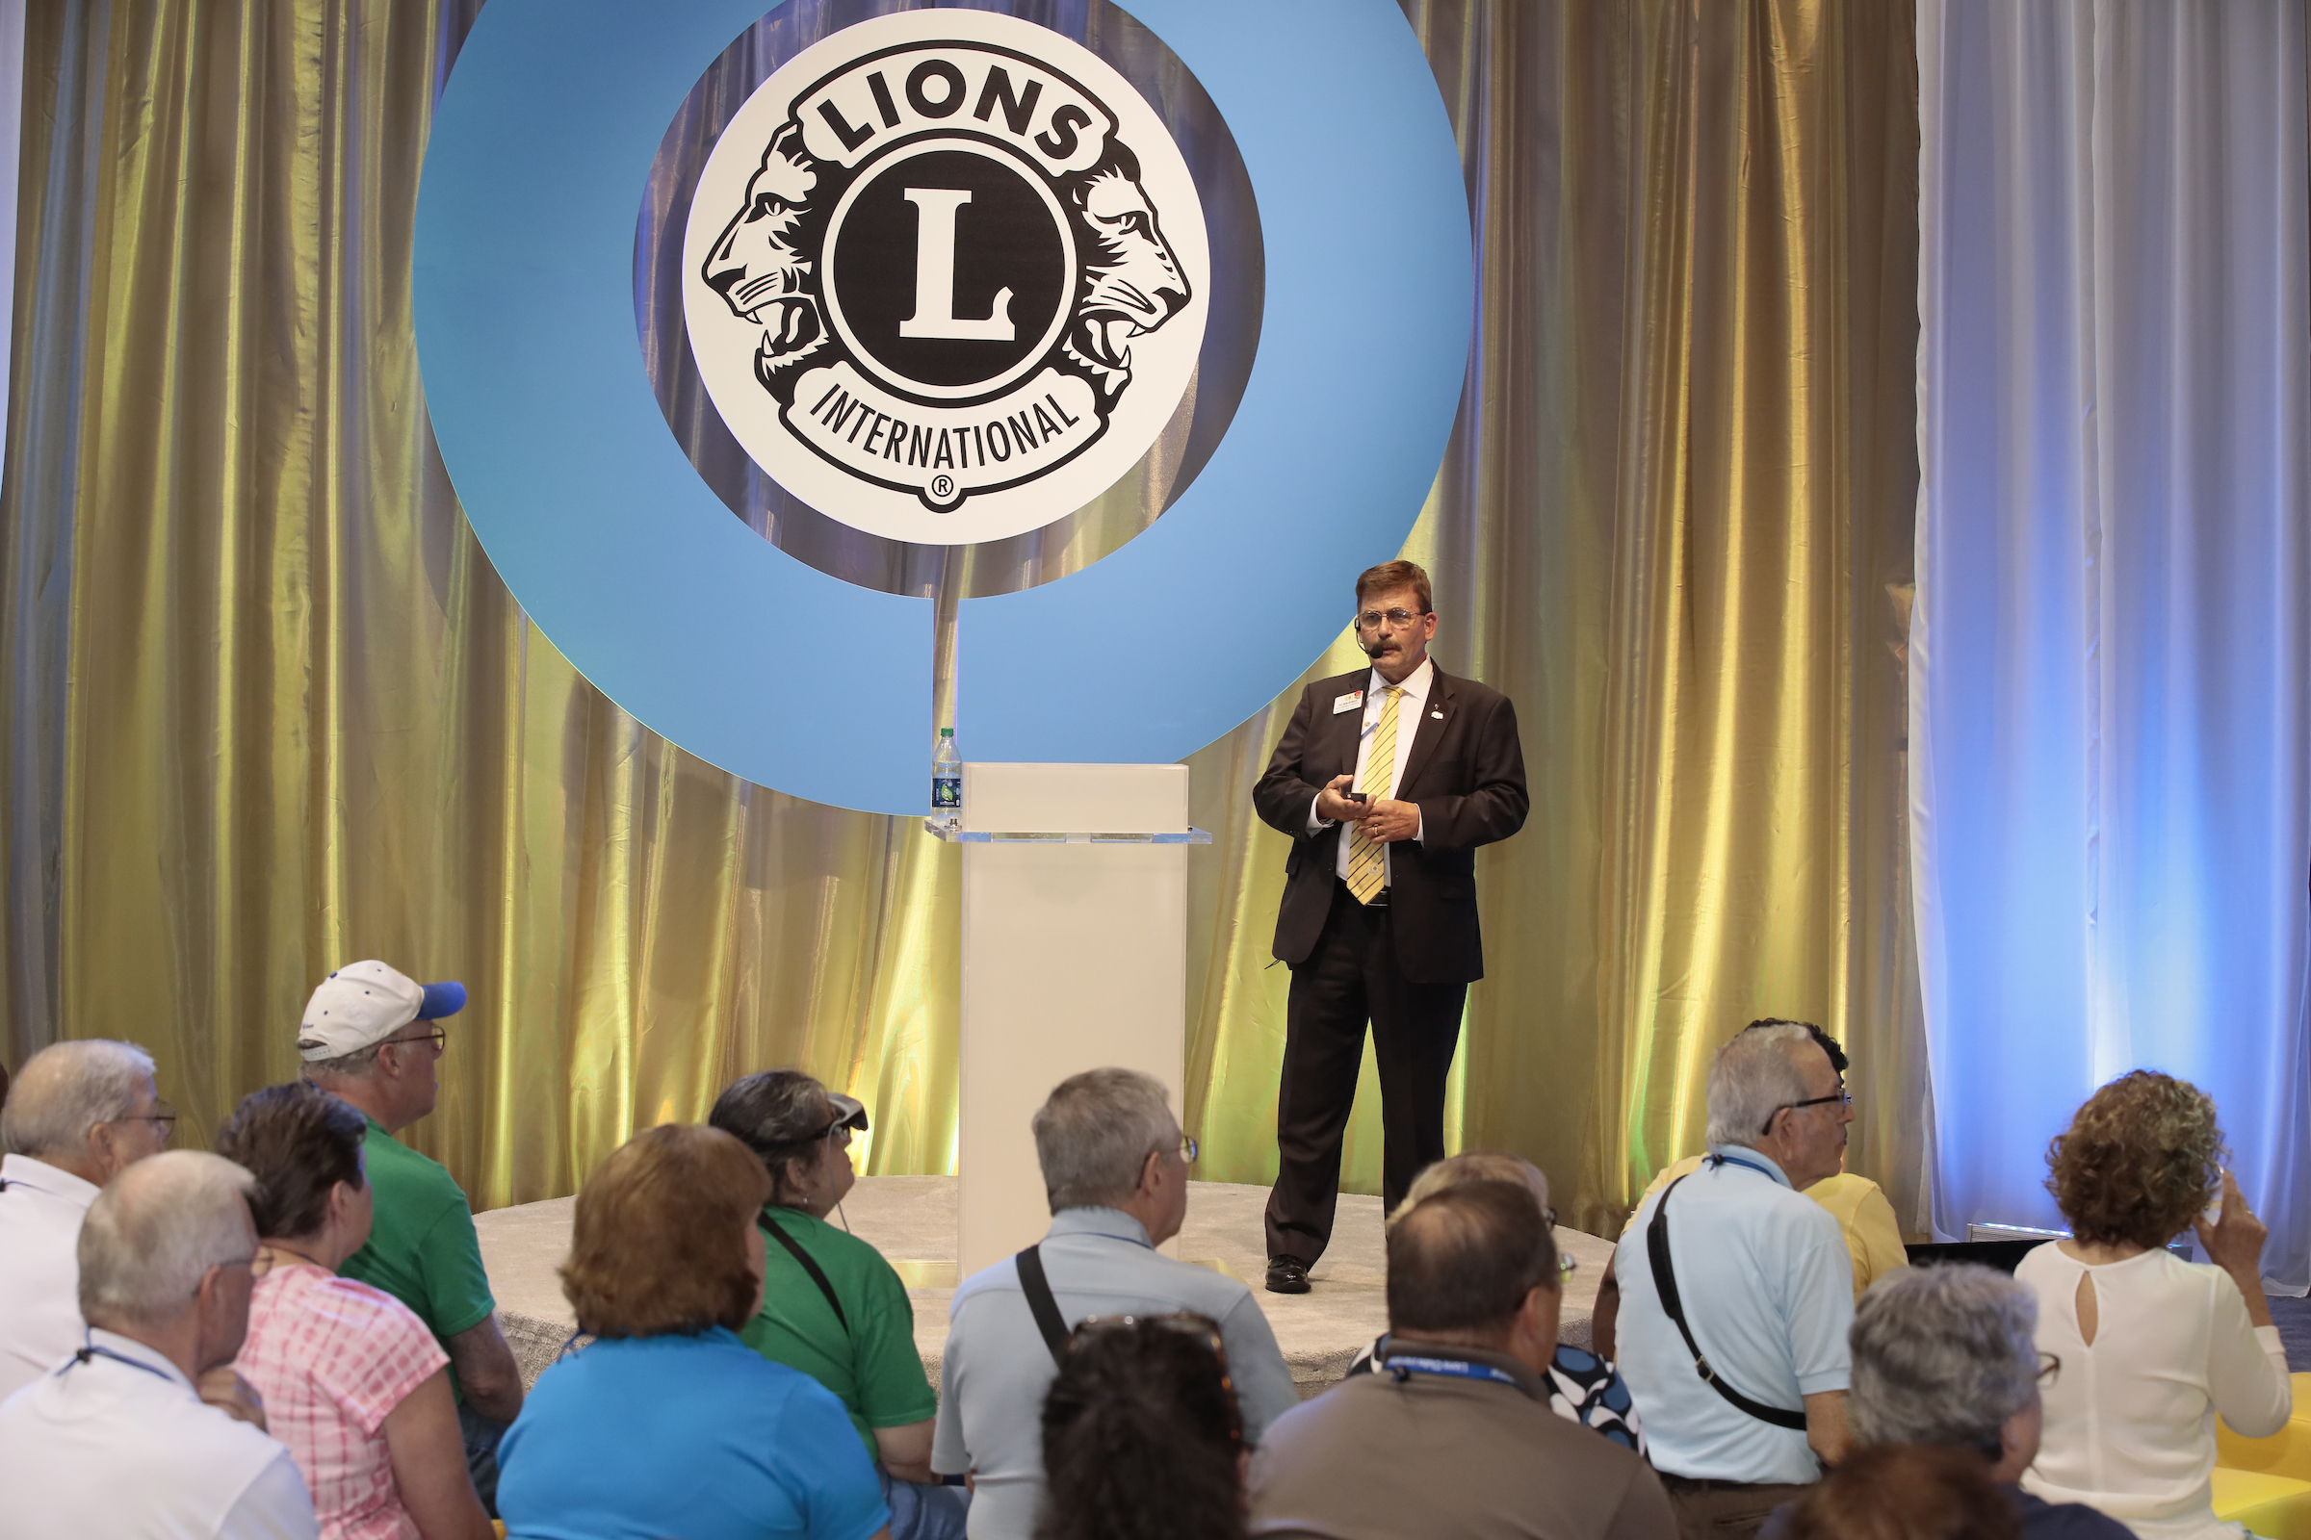
Sharing Ivy Green, Helen Keller’s birthplace, with the world
Centennial International Convention, Chicago, Illinois, 2017

Slide 3
Sharing our vision at the USA/Canada Lions Leadership Forum, Reno, Nevada, 2023

Slide 4
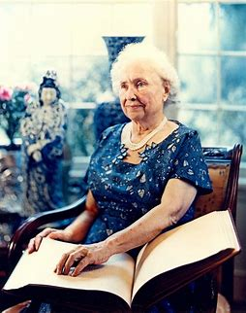
Helen keller June 27, 1880 – June 1, 1968
“I am only one;
but still I am one.
I cannot do everything,
but still I can do something.
I will not refuse to do
something I can do.”
Helen Keller
Notes:
As you know, n extraordinary relationship was formed between Helen Keller and the Lions of the world in 1925 when Miss Keller addressed the delegates of the Lions Clubs International convention in Cedar Pointe, Ohio. It was then that she challenged the Lions to join her and become “Knights of the Blind” in the crusade against darkness. The Lions present whole-heartedly accepted her challenge and thus, Lions adopted vision care as their world-wide area of service.

Slide 5
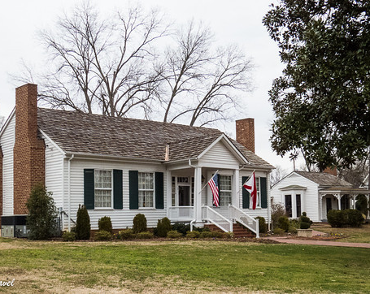
Helen Keller birthplace IVY GREEN, TUSCUMBIA, ALABAMA
Notes:
The City of Tuscumbia, Alabama acquired the Birthplace of Helen Keller, which is now situated on a ten-acre tract of land in 1951, and a dedication ceremony was held on Helen’s birthday, June 27, 1952. Through the efforts of the Helen Keller Property Board and the State of Alabama, Ivy Green was made a permanent shrine to the “miracle” that occurred in a blind and deaf, seven-year-old girl’s life and was placed on the National Register of Historic Places in 1954. Ivy Green has had as many as 38,000 visitors in a year including people from all 50 states and 30 countries. The live performance of “The Miracle Worker” play is attended by more than 4,000 visitors each year.
Our Multiple District (MD34) is honored to be the home district of Helen Keller’s birthplace. The Keller home was built in 1820 on a 640-acre tract of land by Helen Keller’s grandparents and was passed down to Helen’s father, Arthur Henley Keller. He served as a Captain in the Confederate Calvary, was the editor and publisher of a weekly newspaper, The North Alabamian, an attorney and farmer. The home was used as a hospital during the War Between the States. Having survived untouched through the ravages of the Civil War, Ivy Green, so named due to the abundance of English ivy, is maintained to the smallest detail in its original state. The birthplace cottage, to the right of the house, was originally an office where plantation books were kept. Later, a dressing room and porch were added and when Captain Keller brought his second wife, Kate Adams Keller - Helen’s mother - to Ivy Green - he furnished it as a bridal suite. Helen was born in the cottage, a normal child on June 27, 1880, but at the age of nineteen months an illness left Helen both blind and deaf. Helen’s parents catered to her every whim and Helen became very rebellious and her tantrums became uncontrollable. Helen’s parents sought help from doctor after doctor. They finally were able to meet with Alexander Graham Bell. We know him as the inventor of the telephone, but he was also a famous teacher of the deaf. As a result of his suggestion, the Kellers were connected with a 20-year-old, partially blind orphan and graduate of Boston’s Perkins Institute for the Deaf and Blind, Miss Anne Sullivan. Anne Sullivan arrived in Tuscumbia on March 3, 1887, shortly before Helen’s seventh birthday and she soon realized she would have to get Helen away from her parents to be able to control her tantrums and to teach her. As the story goes, Anne and Helen were put in a wagon and were driven around for hours and then returned to the cottage to make Helen think she had gone away to school, so the cottage then served as a schoolhouse and living quarters for Anne and Helen. It was through Anne’s dedication, determination and persistence that the world was opened for Helen. Mark Twain later called her “The Miracle Worker”. Anne would remain with Helen until Anne’s death on October 20, 1936. After that, Polly Thomson who had been their secretary since 1914, became her companion.

Slide 6
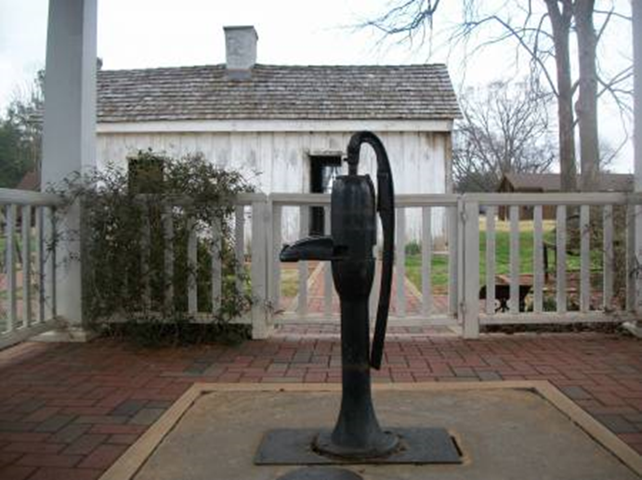
The pump where Helen SPOKE her first WORD, “WATER”
Notes:
Here you see the famous pump where Helen spoke her first word…”water”.

Slide 7
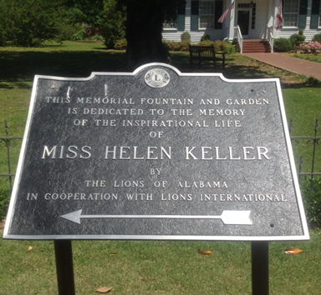
Memorial Fountain and Garden
Notes:
Helen Keller passed away on June 1, 1968. A month and a half later, the Tuscumbia Lions Club adopted a resolution to construct of fitting memorial to honor her extraordinary life and achievements. The resolution had the following statement: MAY THIS MEMORIAL BE OF SUCH MAGNITUDE AS WAS HER DEVOTION TO BRINGING NEW COURAGE TO MILLIONS OF PEOPLE WHO SUFFERED FROM BLINDNESS OR DEAFNESS OR BOTH. Lion Johnny Tuten was named the chairman of the memorial committee. Lion Johnny was the overseer of the memorial for nearly 54 years until his death in 2022. Lion Johnny was known as “Mr. Ivy Green” throughout Alabama. I spent a lot of time with Lion Johnny over the years and now I’m called “Mr. Ivy Green II”. An initial goal was established to raise $10,000 for the project. Lions International agreed to provide a matching $10,000. The Tuscumbia Lions Club raised more than $22,000, giving them $32,000 for their project. A ground-breaking ceremony was held on September 28, 1970. The final cost was $43,000.00 and the Tuscumbia Lions Club raised another $13,000.00 to cover the expenses. During construction of the memorial, they began a letter writing campaign to clubs around the globe soliciting gifts, to be incorporated into the memorial, to show their appreciation of Helen Keller and to honor her inspiration that led Lions to serve the visually impaired. After nearly three years of intense efforts, the Lions of Alabama, in cooperation with Lions International, dedicated the memorial fountain and garden on May 20, 1971. This was later renamed as the Lions Helen Keller Memorial.
The Tuscumbia Lions kicked off their fund-raising campaign from a small booth at the North Alabama State Fair in the fall of 1968. Once the news of the planned memorial spread throughout the area, donations began to come in from individuals, other civic organizations, and of course, other Lions clubs. Lions clubs in Alabama were challenged to give a minimum gift of $2.00 per member. One hundred percent of the 234 Lions clubs throughout Alabama responded to the challenge.

Slide 8
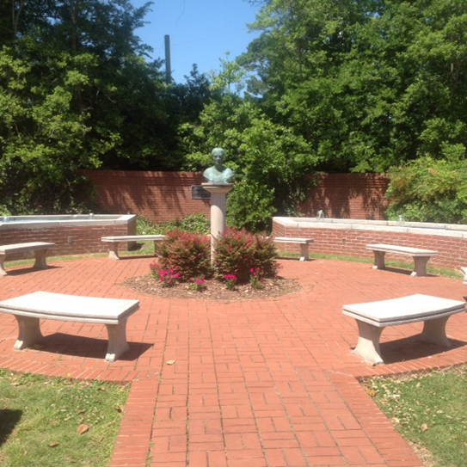
Notes:
The main feature of the Helen Keller Memorial is a fountain and garden area featuring four separate sections of fountains. In the center you see a bust of Helen Keller on a pedestal. Margaret Whetsone, a 90-year-old sculptress from Montgomery, Alabama, came out of retirement to create a bust 1.5 times life-size of Helen Keller as her last piece of art. She also created two plaques. One of the plaques was presented to the Alabama Department of Archives and History, and the other to Lions Clubs International headquarters in Chicago, Illinois. Ms. Whetsone reportedly said “For nobody else in the world but Helen Keller would I do it.” The bust she created remains in the center of the fountain and garden area to this day.

Slide 9
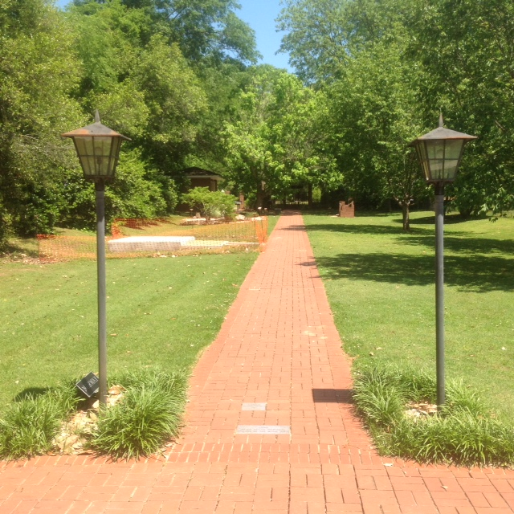
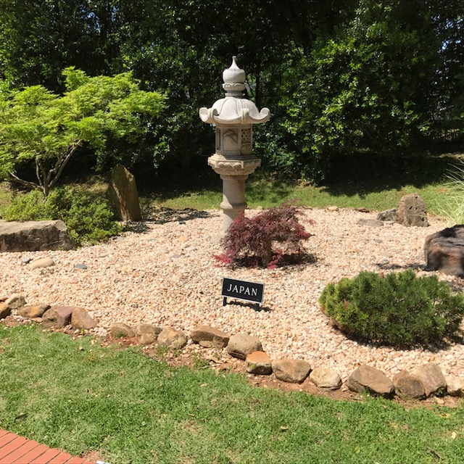
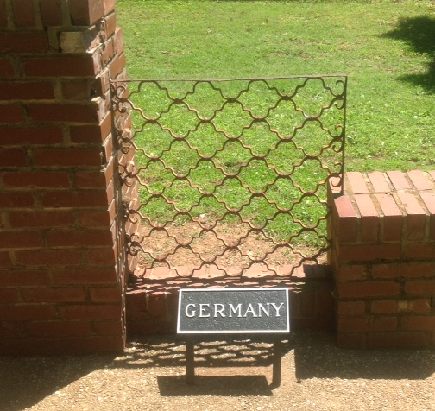
Gifts to the memorial
Notes:
Gifts were received from numerous countries, thus making the memorial a truly international project and reflecting the impact Helen Keller had on the world. Gifts of all sizes and shapes were received. Several of the gifts are displayed along what is now known as the “Knights of the Blind Walk”. The Lions of Norway sent a pair of street lampposts. a large lantern was donated by the Lions of Japan; a section of hand-forged metal work; a weathervane from England; a drum from Korea; large wood carving from Kenya; and the list goes on and on. The generosity of the Lions of the world signified the large scope of Lionism as well as the extent to which Helen Keller touched the world.

Slide 10
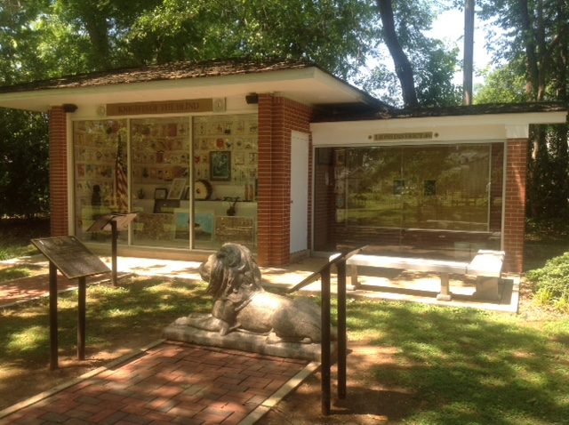
Notes:
A structure was built to house many of the smaller gifts and those needing protection from the weather. It also houses friendship banners from around the world and a monitor that continually plays a re-enactment of Helen Keller’s famous speech to the Lions at the 1925 International Convention in Cedar Point, Ohio where she challenged us, the Lions of the world, to become “Knights of the Blind in the Crusade against Darkness.” The smaller addition on the right was dedicated in 2009. It was built by the Lions of Nevada Multiple District 46 and houses plates recognizing their contributions to the memorial. They also donated the Lion statue and the two bronze plaques shown in the picture.

Slide 11
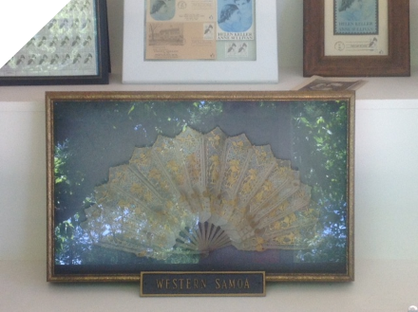
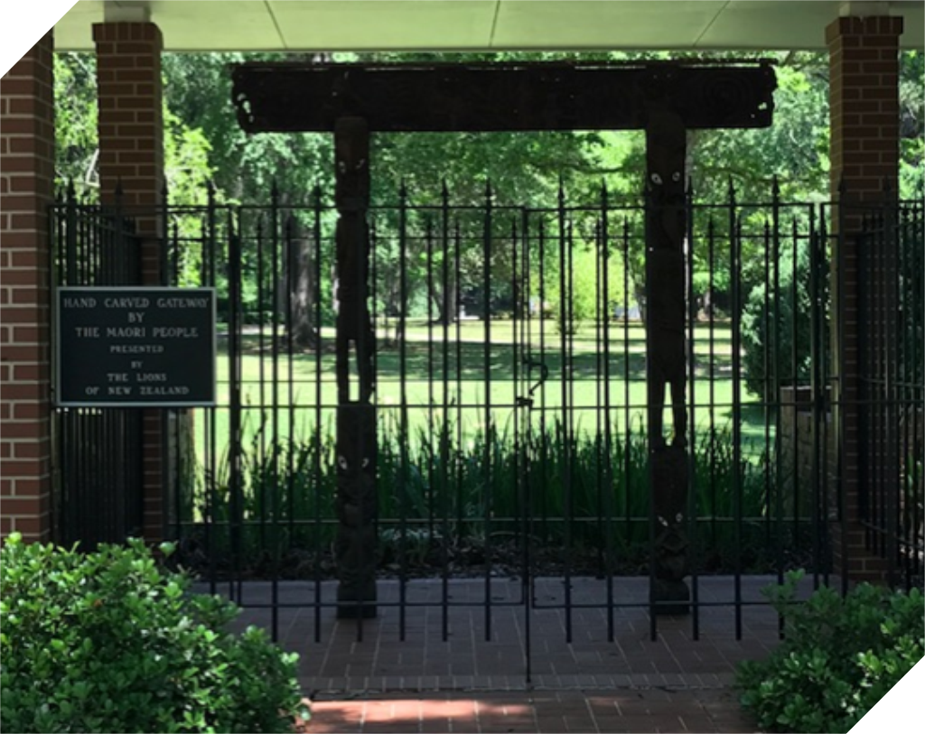
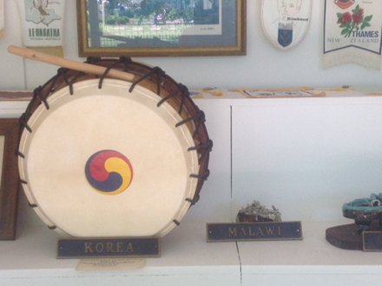
Notes:
The three pictures on the left are examples of the types of gifts on display behind the glass wall of the building you just saw. At the end of the “Knights of the Blind Walk” visitors can view a hand carved wooden structure from the Maori people of New Zealand. It was commissioned by the queen of the Maori people. This extraordinary work, is a copy of a memorial to a paramount Maori Chieftainess of the 17th century. According to history, a gift of this type is seldom made, and the history of this carving goes deeply into Maori tradition. The piece is 8’ high and 6’ wide and is designed to function aa a gateway. It is made of New Zealand Totara timber and is ornamented with fully carved Maori figures. These figures are in pairs, one always representing the deformity of man, the other representing the spirit of man striving to overcome the weaknesses of the flesh. The work was closely inspected by the queen, but only after it was completed. By Maorian tradition, no woman may enter the workshop. Even though the workmen spent an estimated 3000 hours of painstaking work, no payment was made to the workmen who created the gift. This also is a
tradition of the tribe. This gift was presented on behalf of the queen by Lion Rex Allen after attending and being sworn in as a District Governor at the International Convention in Atlantic City, NJ.

Slide 12
Gifts to the memorial from many countries are on display, including:
Antiqua, Australia, Canada, England, Finland, France, Germany, Greece, Guyana, Iceland, Ireland, Ivory Coast, Jamaica, Japan, Jordan, Kenya, Korea, Netherlands,
New Zealand, Norfolk Island, Norway, Panama,
Paraguay, Philippines, Samoa, Scotland, Sweden, Switzerland, Tanzania and Uganda

Slide 13
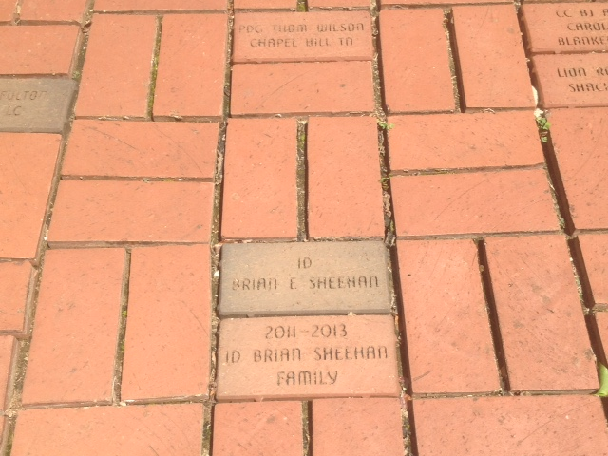
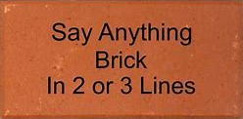
THE “KNIGHTS OF THE BLIND WALK”
* 16 characters per line. Spaces count as a character.
Notes:
The “Knights of the Blind Walk” was established in 2006 as a means for individuals to donate to the Helen Keller Memorial and at the same time place a brick in honor or in memory of someone or to have their name added to the walk. Many Lions Clubs have purchased bricks depicting the name of their club. One club in particular purchased a brick for each of the nine members of their club that has served as District Governor and bricks for their members that have served as President of the Alabama Lions Sight Conservation Association. Many clubs have purchased a brick in honor of their Lion of the Year. Bricks can be purchased for $100.00, All proceeds from brick sales help defray the costs of maintaining the memorial.

Slide 14
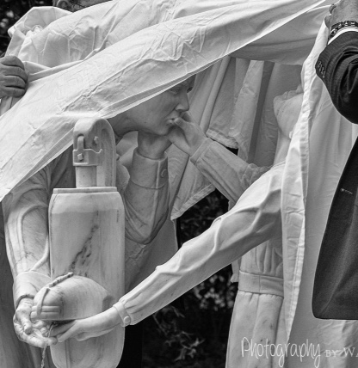
MD-34 CENTENNIAL Legacy project
Notes:
Let’s back up for a moment and talk about the latest addition to the memorial. As one of our Multiple District Centennial Legacy Projects we elected to place a life-size statue of Anne Sullivan and Helen Keller along the Knights of the Blind Walk. The statue is made of Sylacauga white marble, know as one of the finest quality marbles in the world, from Sylacauga, Alabama. It was sculpted by world-renowned sculptor, Craigger Browne, who named the piece, “Warmth of Enlightenment”.

Slide 15
Sculptor: craigger browne
Notes:
We commissioned Birmingham, Alabama native, Craigger Browne as the sculptor of our statue. Craigger majored in Fine Arts in college and then he studied at the Cleveland Institute of Art in LaCoste, France for a year followed by a year there as an Assistant Professor of Sculpture. He is a recipient of a Guggenheim Scholarship, which allowed him to work with restoration and conservation on the Peggy Guggenheim Collection in Venice and Carrara, Italy working with artisans to master the sculpting trade. Craigger has sculpted and sold his works from Italy and the United States. He has exhibited in France, Italy, and throughout the United States and his work is in private and corporate collections on five of the seven continents. Since beginning work on the statue, Craigger became a Centennial Charter member of the Sylacauga Lions Club and currently serves as the club president. He is shown here with another piece of art he created that sits in front of his local library.

Slide 16
Notes:
After much research and planning, work on the legacy project began with the delivery of a 24,000-pound block of marble and the delicate procedure of sculpting soon began.

Slide 17
Notes:
Here you see Craigger delicately removing un-needed sections of the marble.

Slide 19
Notes:
Here you see how the components of the statue begin to take shape.

Slide 20
Notes:
As the figure of Anne Sullivan began to reveal itself, Craigger painstakingly marked key measurements to ensure the figure would be anatomically correct as he proceeded to carve her from the marble. Approximately 5 months into the project as Anne was emerging well…the unexpected happened. Craigger encountered a major flaw in the block of marble where Anne’s skirt was to be. The work was immediately halted. Craigger was going to have to start all over again. A new block of marble was acquired from the quarry and Craigger did just that…he started all over again!

Slide 21
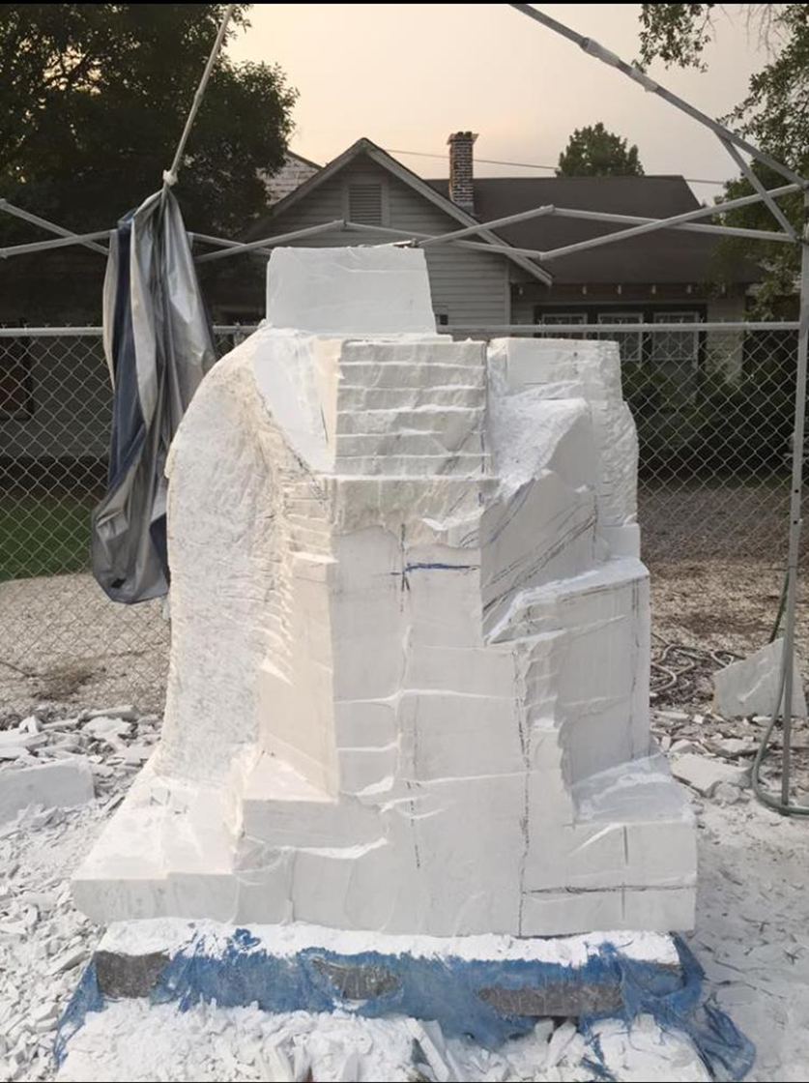

Slide 24
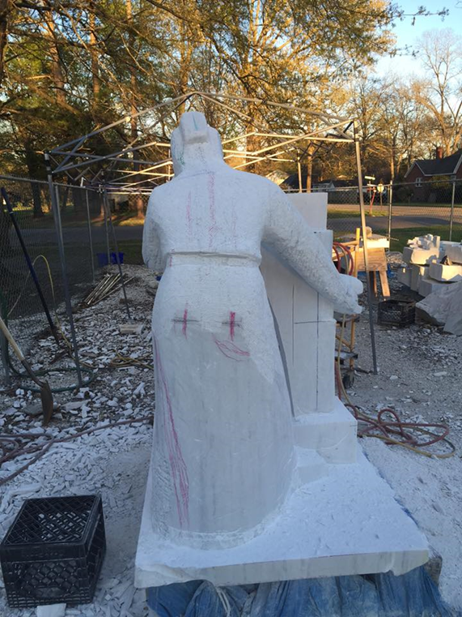

Slide 28
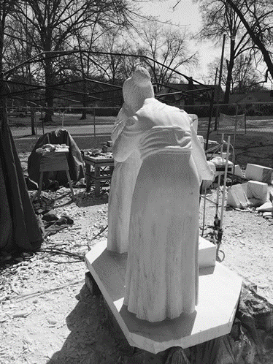

Slide 30
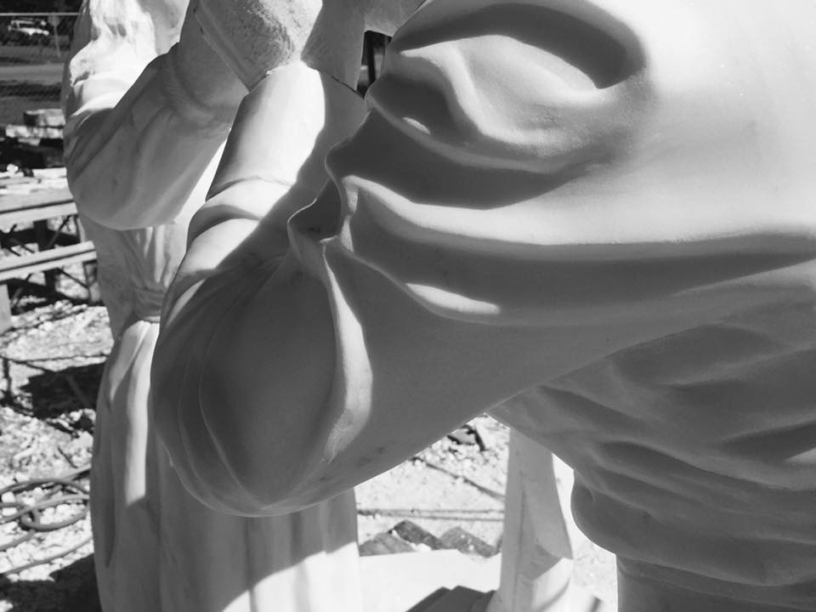

Slide 32
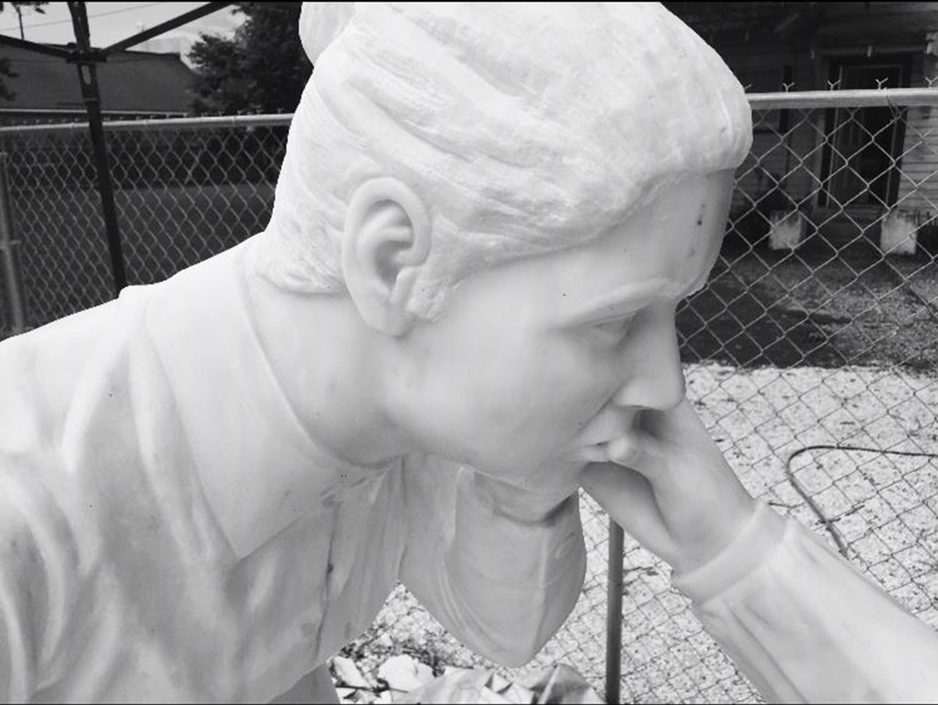

Slide 34
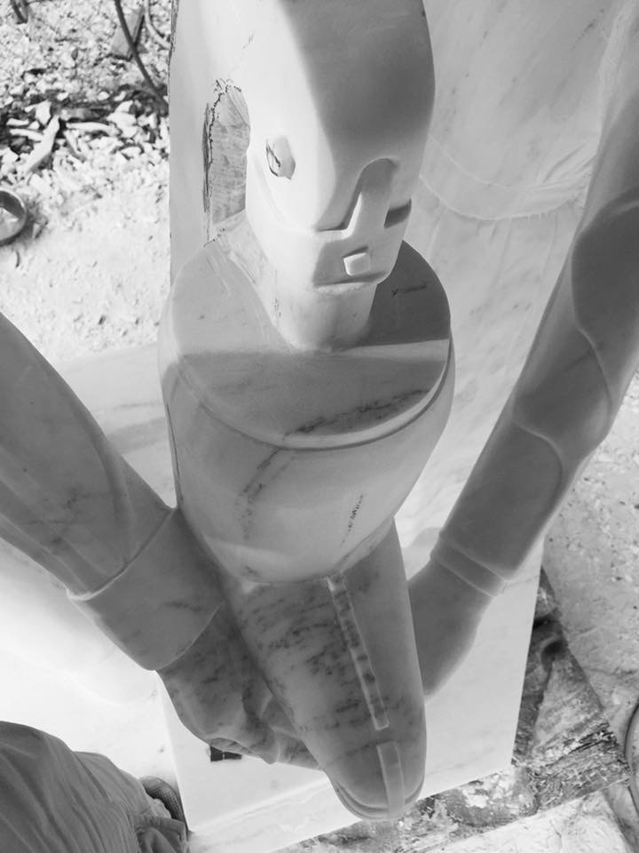
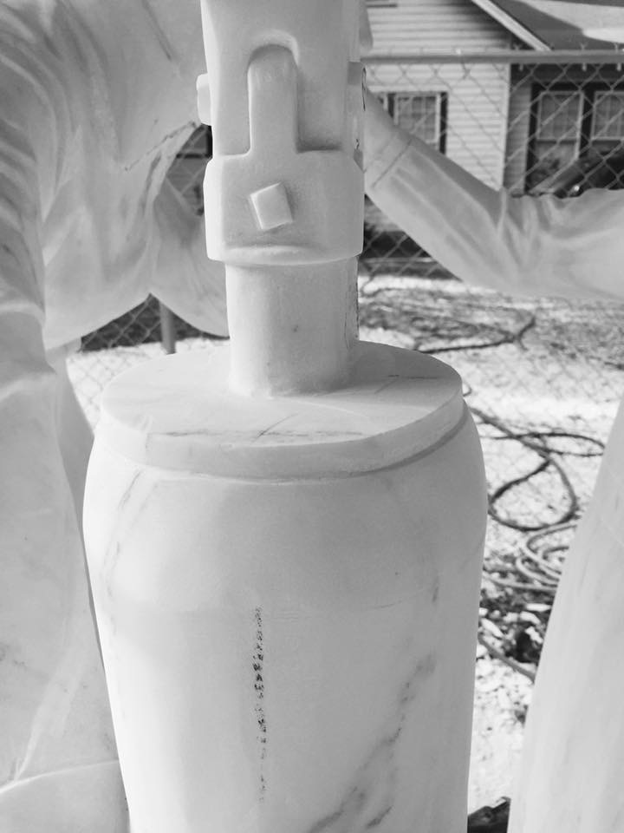

Slide 41
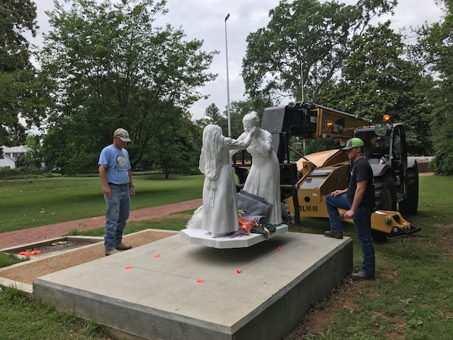

Slide 49
Notes:
Unveiling and dedication September 9, 2017. PIP Chancellor Bob Corlew was the keynote speaker

Slide 53
“
Multiple District 34
Centennial
Legacy Project
“The Warmth of Enlightenment”

Slide 54
What’s next?

Slide 55
Signage with both braille and English
Program for self guided tour
Brick locater system
Sensory garden
“Walk of Courage” Experience
Picnic pavillion

Slide 56
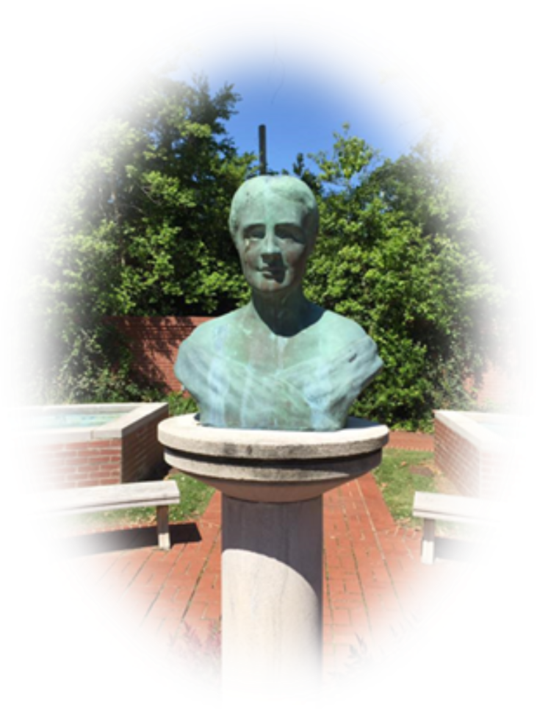
Have you ever wondered where we, as Lions, would be had Helen Keller not issued her challenge to us in 1925?

Slide 57
Questions ?
Comments

