Slide 1
Public Speaking
Lions University 227
Facilitator: ID Dave Wineman
Notes:
Just a note… Be prepared to say and complete the following sentence…
By improving my public speaking skills, it will enable me to be a better leader in Lions by…
-or-
My Joy of being a Lion is [finish in one or two sentences only].
OK to Errrr if they miss the my joy of being a Lion part.
Meant to teach Lions simple speaking start and an elevator speech.

Slide 2
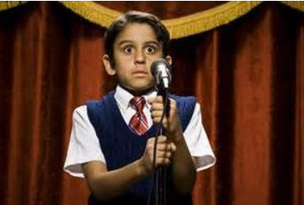
Notes:
You’ve lost that loving feeling….
How’s that new public speaking thing going?

Slide 3
Notes:
Well at least we got them to come! Oh, it was a mandatory meeting…

Slide 4
Look Familiar???
Notes:
Look Familiar? Remember our “good ‘ol days” lined up n the gym wall at the school dance?

Slide 5
Shout it out!
Notes:
Shout it out!
Talk about what we do.
Bring magic to our experiences as Lions. Look at your heart of service!
Make your mark!
Set the pace!
We are leaders!

Slide 6
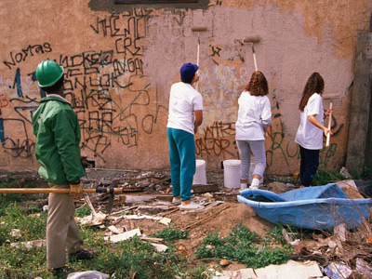
Notes:
We bring a mountain of important, appreciated and relied on services to our community!
So quit horsing around and get that message out there. Communicate it!
How are you going to Make Your Mark?
How are we, as leaders of Lions, supposed to get our message across?
And speaking of getting that message across, during this presentation be ready to stand up and shout “Make Your Mark” when you see the presidents emblem. Then tell the room in one or two sentences ONLY… “Your joy of being a Lion.”
So let’s just practice… When you see the presidents emblem, everyone stand and shout, Make your Mark.

Slide 7
Make Your Mark
Improving my public speaking skills will enable me to be a more effective leader of Lions.
Notes:
Give second or two for the audience to recognize the presidents emblem and tell their joy of being a Lion.
Jump up and shout (or just shout) and yell, “Make Your Mark”.
Then say, “My Joy of being a Lion is” and complete the phrase with one sentence or at the most two sentences. Go over that and get a “Errrrr”

Slide 8
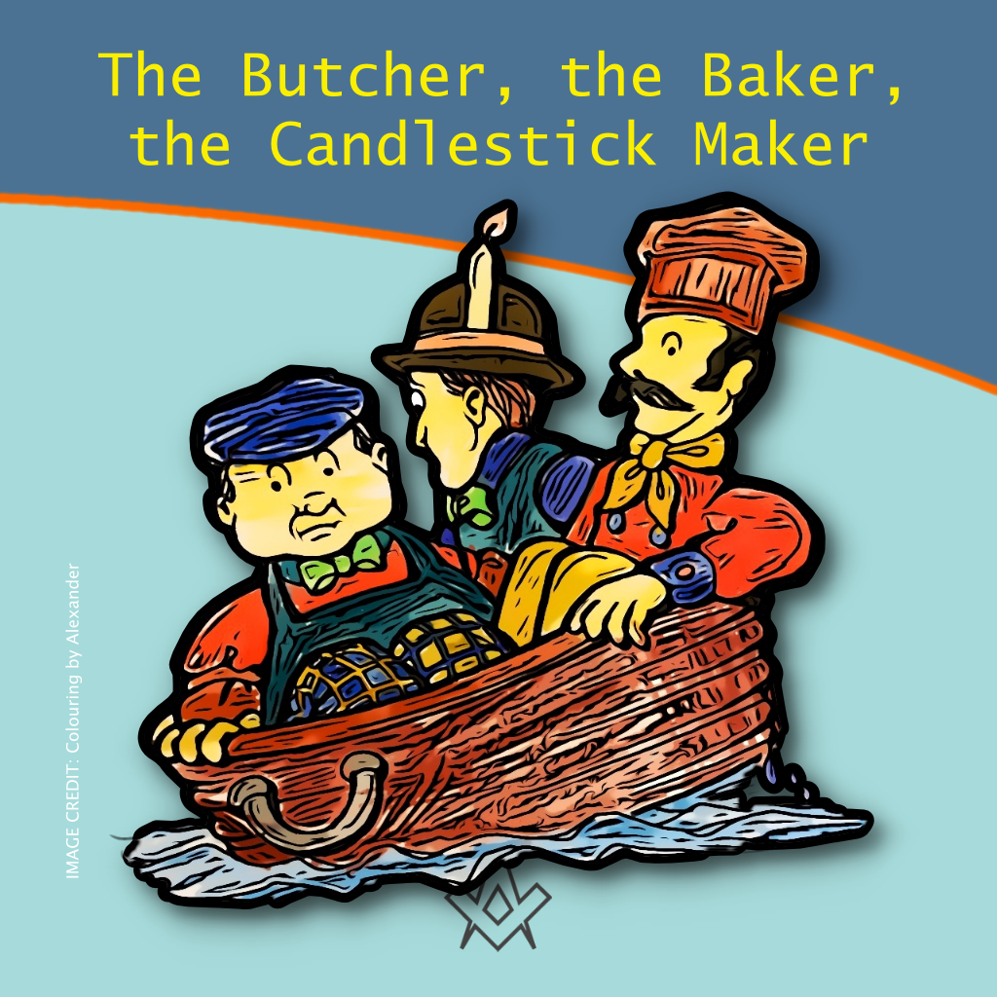
What’s the difference?
Facilitate
Mentor
Coach
Notes:
Let’s lay a little foundational groundwork…
Facilitate = verb, to make something easier
Mentor = also a noun or a verb, but used to describe the process of a relationship between two or more people where all the parties are learning and developing.
Coach = like a mentor can be both a noun and a verb, where the coach is the expert, already knowledgeable on a process.
So different delivery styles, affect the entire presentation.
Personally, I prefer the mentor as the mentor is always developing and always involved. It also allows for reverse mentoring.

Slide 9
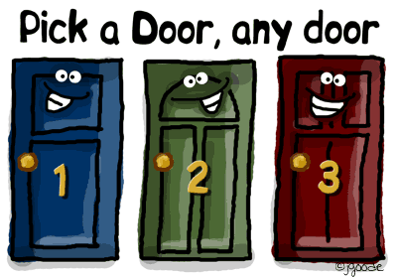
Public Speaking Categories
Inform
Entertain
Persuade
Know why you are speaking!
Know what your desired outcome is of your talk.
Notes:
05:00
Ask yourself, “What am I trying to accomplish?”
Maybe you were asked to do a presentation. What did my requestor desire to do?
Public speaking falls into 3 general categories for the most part….
Inform
Entertain
Persuade
Know why you are speaking!
Whatever the desired outcome play towards that goal.

Slide 10
Basic Layout
Introduction or Hook
Body - Substance
Generally 3 or 4 Points
Conclusion - Challenge
Notes:
05:00
Introduction
Jokes
Main body – the meat and potatoes
3 to 4 points generally that fit your time slot
Conclusion or Challenge (What you want your audience to do.)

Slide 11
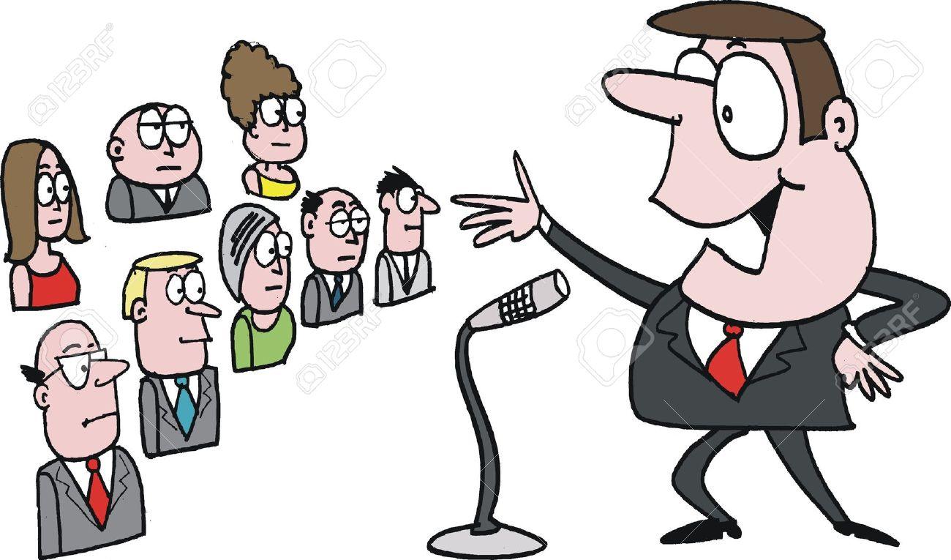
Know Your Audience
Speak their language
Keep within their knowledge level (plus a little)
Care using Acronyms
Notes:
08:00

Slide 12
Substance Over Style
Notes:
Whatever, whenever and however you get that golden opportunity to speak in front of an audience of people always remember….
Choose substance over style. Content that is usable, sincere and helpful to your audience is always better than any of the delivery frills. Be it a flashy video or a bowtie. Things can and will go wrong with delivery. If the meat and potatoes are there then there still is a benefit for your audience.
When delivering substance remember to fit your time window. This helps determine depth and quantity of information. If that isn’t complicated enough, fit your audience to your depth plus a fraction of new material.

Slide 13
Be Prepared!
Equipment Failures
Hostile Audience Members
Unexpected Emergencies
Your own personal needs
Take a moment before you start to get your head in the game
Fear
Notes:
11:00
Bummer the equipment doesn’t work like we think it should.
Sometimes we will run into audience members that are difficult to handle.
Health issues, power going off, microphones that don’t work,
Use the bathroom ahead of time. Have a glass of water handy. Just water, no ice, no coffee.
One of the biggest problems is stage fright. Worry about failure. Fear is our best friend and its our worst enemy if we let it. Build your comfort level.

Slide 14
Prerequisites
Know the subject
What do you want to accomplish?
What is the time slot? Make your time count
Be a Leader!
Notes:
Know your subject. There will not be any time to google things when you are presenting…. Unless you are sitting in the audience. Then look out!
Know what you want to accomplish! Why on earth are we even here?
Make your time count. Coupled with the fact that verbal conversation is only 20% of the overall conversation – TIME IS REALLY VALUABLE! So generally…
People have judged you in the first 2 seconds of meeting you. Some say a half a second.
They take queues from around the room.
They look at your appearance.
If you are too good, they find ways to put you down to their level.
If you are struggling life rings are in short supply.
No matter what… Act and be a leader. The moment you shy away from this all of your credibility goes out the window.

Slide 15
Content
Draw from personal experience
For LCI content, draw information from the LCI website
Bring in an expert
Your content and time slot must be doable!
Prepare, prepare, prepare! Then prepare again.
Notes:
The best topics are topics in which you have lived them. You are an expert.
If you are presenting on LCI topics, draw from your own personal experience, BUT do update with the information from the LCI website.
If you are not an expert on a subject consider phoning a friend.
- co-present with the an expert
- maybe you bring something like a connection to the crowd. Use your assets that you bring.
- if it is a power point talk, consider ping ponging with the expert and relating it back to your district.
- two minds are better than one.
What you cover must fit the time slot available.
And remember prepare only for the talks that you want to be successful in.

Slide 16
Venue
Know how to get there.
Room layout – Roaming?
How many people are you speaking to?
Know your surroundings before your talk
Lighting?
Background Noise?
Notes:
18:00
When In Rome, do as the Romans. That is unless you really want to be different, but be careful on that one.
Have your equipment ready.

Slide 17
Getting Started
Start with a 3 minutes talk
Talk about something you know well
Talk with your club or some friends or even privately
In the first 2:50 share what you know
In the last 10 seconds challenge them to an action
Notes:
Like any skill we have to start somewhere.
Try talking for 3 minutes. It is a nice simple short talk.
Talk about something you are an expert in or know very well.
Position your audience to be someone that you are comfortable with.
In the first 2:50 seconds share your knowledge and your points that you want your audience to understand.
Finally, sum up your talk with a 1 sentence and one sentence only challenge. Challenge your audience to do some action. Bring the purpose to a close with action.
This method works very well in Lions Clubs for reports.
Think about this. How many reports end in a challenge for action? How many should?

Slide 18
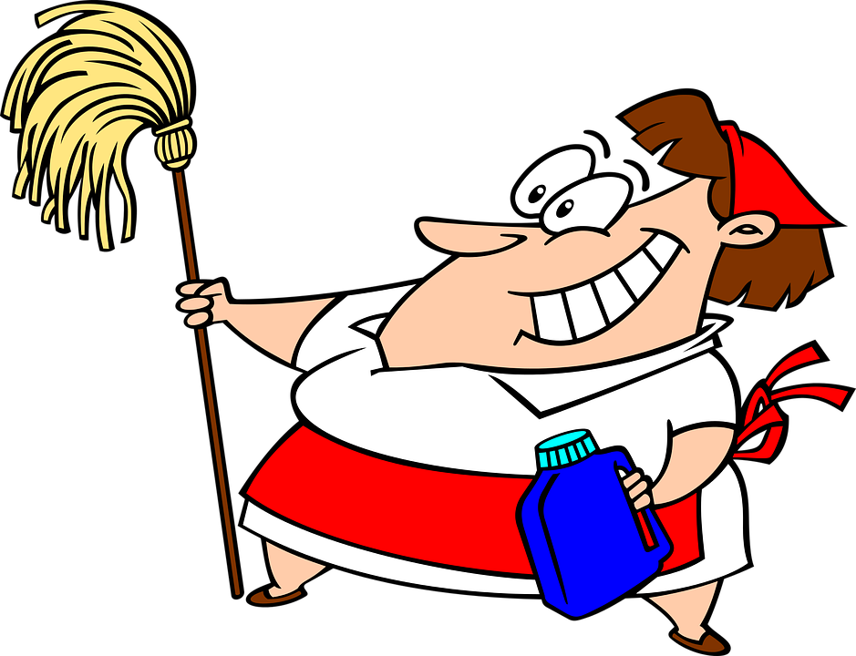
Polish Your Craft
Include people's names
Draw parallels from your audience
Have a handout for clarity and points
Eye contact with the audience
Props
Microphones are ALWAYS on.
I’ll mop the floor with you then polish you off!
Notes:
24:00
As time goes on there are ways to polish our talks.
Include peoples names as we are speaking.
Use handouts
Make eye contact with your audience.
Props can be handy, but be careful.
Remember that microphones are ALWAYS on. Just ask the Royal family.

Slide 19
Practice
Rule #1… Practice ahead of time
Rule #2… Repeat rule #1
Phone a friend
Polish your presentation
Incorporate audience feedback (Future)
Notes:
Rule #1… Practice.
That’s rule #2 as well. Only practice as many times as you want to be a success with your talk.
It is a huge benefit to have someone to bounce your presentation off of. Pick someone who is honest and is willing to deliver difficult news.
Follow your heart when it comes to content.
Continue to polish your presentation right up to deliver time.
Once you have delivered your presentation listen to audience feedback. Especially watch for negative feedback. Sometimes as speakers we offend rather innocently due to cultural, habits or other nuances. This helps down the road when you want to give the presentation again.

Slide 20
Things you can do pre-speaking...
If you are already standing there then be friendly and talk with the audience.
If you are introduced generally go straight into your hook.
If you are sitting at a head table explore if appropriate.
Listen for opportunity.
Notes:
29:00
You’re entire time at a venue is available to engage your audience. Public speaking starts BEFORE you hit your venue. It is when you are first asked. It continues AFTER you get home.

Slide 21
Other Rehearsal Items
Video record
Audio record
Say it aloud
Use a mirror
No booze, drugs, mind inhibitors
Continue till you’re comfortable (but NOT memorized)
Keep polishing the results
Play act audience feedback (especially all your hangups)
Plenty of rest
Notes:
33:00

Slide 22
Look & Feel
Stand up straight
No reading, notecards
Eye contact
Look for questioning people
Open hand gestures
Attempt to visualize oncoming challenges
Notes:
39:00

Slide 23
Bolt Ons
What’s a bolt on?
Allow time management (3-4 minutes per bolt on)
Benefit of adaptation of a broad audience
Just keeps getting more and more polished
Practice transitions
Watch repetition. Keep doing new material.
Careful to maintain depth
Notes:
Let’s talk about talk structure a little. Sometimes the situation requires different length of times to speak. How do you get past that without creating a new talk each time you speak?
Bolt Ons!
Describe what a bolt on is. These are your 3 or 4 major points.
Frequently when one is speaking we are put under different time constraints. This helps manage time.
A good bolt on time is 3-4 minutes.
Allow adaptation to a wide audience.

Slide 24
The Show Must Go On
Mistakes are normal. Keep moving.
Only correct yourself if you said something wrong
Don’t burn time with the antagonizer, stumper
Anticipate there will be a curve ball
Stay Positive, humble
Humor (if you can manage it) helps
Don’t Stop! (most of the time)
Notes:
If there is one constant in this universe… It is the fact that there will be things that are unplanned. Sometimes they are just little things even. Accept that it is going to happen.
One of my best examples of this was PID Tom Matney. We were presenting at the Indiana Winter Forum. It was a wet winter day. The roof in the hotel must have had a leak. Welll, let’s hope that it did. The ceiling was wet. Minutes before the talk… You guessed it. Buckets – and I mean buckets of water came down on PID Tom. You know what he did? You guessed it. A smile, a quck joke and the show went on. Instead of focusing on himself, he focused on his subject.

Slide 25
Two Tools
Positivity
Encouragement
If you want your audience to believe you it has to be their idea!
Notes:
45:00
In everything you do, there are ONLY two tools that are effective. Positivity & Encouragement.
People turn off negative.
They are taught to defeat stress or pressure and shy away from it. No point in being a high pressure sales person.
The most effective presentations get the person to apply your talk to their lives and they discover something about themselves.

Slide 26
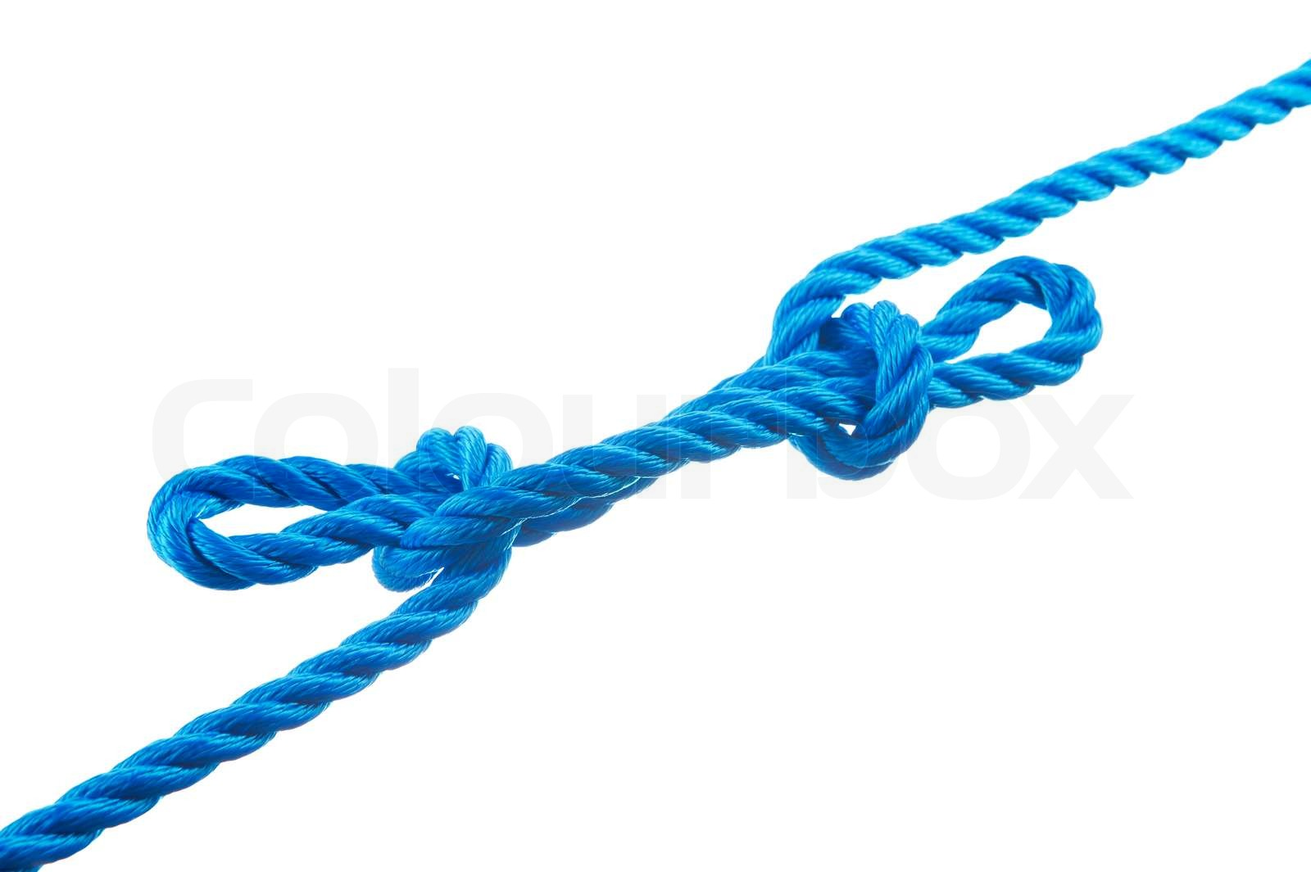
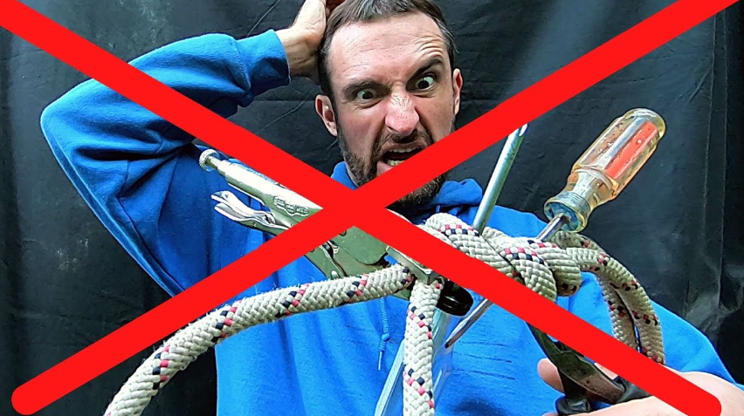
Untie the NOTS!
Work at dumping the word NOT!
… and the ‘nt contractions too!
Notes:
For many of us it is a life long endeavor… Stop using the word not and it various contraction forms.
It sets a negative tone in the room.

Slide 27
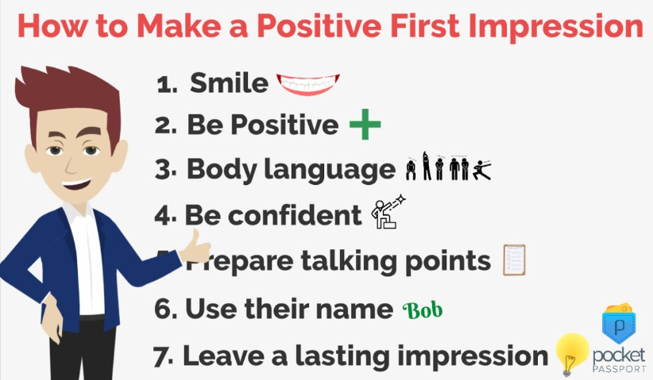
Leave With a Favorable Impression
No telling someone off
No running away
Be humble
No arguing
Smile – Always!

Slide 28
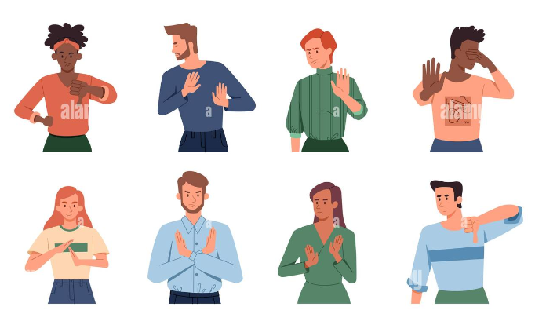
Non Verbal Feedback
You’ve been judged before word 1
Avoid negative looking people
Maintain eye contact. Talk with people.
Change your pace & physical activity
Watch for questioning eyes
Watch for disagreement
Folded arms. Sitting back from a table.
Open palms

Slide 29
Nevermore…
Turning Your Back to the Audience
Hide behind objects
Negative (Criticize, Condemn, Complain or Gossip)
Eating (unless you bring enough for everyone)
Swearing
Joke Telling
Fold Arms
Hands in pockets or jingle change or fiddling
Read or memorize your message
Notes:
54:00

Slide 30
Nevermore…
Sexual Inuendo
Constantly call on the same person
Wing it
Embarrass someone
Wipe nose on your sleeve (unless you have a green jacket on)

Slide 31
Forever and Always…
Practice
Make eye contact throughout audience
Relate back to the audience
Turn the cell phone off or down
Recognize the entire audience
Keep the audience engaged

Slide 32
Forever and Always…
Start with a strong opening
Stay positive & Be Professional
If you miss a point move on
Have your handouts ready. No fumbling.
Have a backup plan
Be Positive!

Slide 33
Forever and Always…
Have FUN!
Friendly, Upbeat & Nice!
ID Dave Wineman 2024-2026
Notes:
61:00

Slide 34
Resources
Lions Learn
Lions University, Course 227
Dale Carnegie www.dalecarnegie.com/
Toastmasters www.toastmasters.org/education/pathways
Jaunty www.jaunty.org/blog/public-speaking-tips/
Cabinet Meetings
*** Always carry membership applications with you!!!

Slide 35
Call to Action
Public Speaking is a skill. Practice. Be positive. Change peoples lives. Make your mark.
Notes:
65:00
Questions?

Slide 36
Public Speaking…
J
O
Y
Journey
Opportunity
Yield
ID Dave Wineman
Notes:
Public speaking…
Experience the journey.
Seize the opportunity to speak about it.
Yield results for our fellow Lions and friends.
Always make the most of your opportunities.

Slide 37
Questions
Notes:
65:00
Introducing President Fabrício Oliveira and Make Your Mark
• Our international president is Fabrício Oliveira, from Catolé do Rocha, Brazil.
• “We Serve” is President Fabrício’s theme. This reminds us of who we are and what we do as Lions.
• President Fabrício’s message to Lions is “Make Your Mark.” Every time we serve, we make our mark in our communities.
o Every *me we bring a new member into our club, we make our mark on the future of our service.
o With every life we touch, we make a mark that will never be forgotten.

