Slide 1
Leader or Boss?
Leadership styles that motivate volunteers.
(Volunteer vs Voluntold)
PDG Dave Wineman
Notes:
1:50 – 0:15 – 2:05
The title of this presentation is Leader or Boss? Leadership Styles that motivate volunteers. Originally, this was titled Volunteer vs Voluntold. The forum asked me to do a bit different presentation than Volunteer vs Voluntold. Somehow the old title slipped in. The contents are similar, but slightly different.

Slide 2
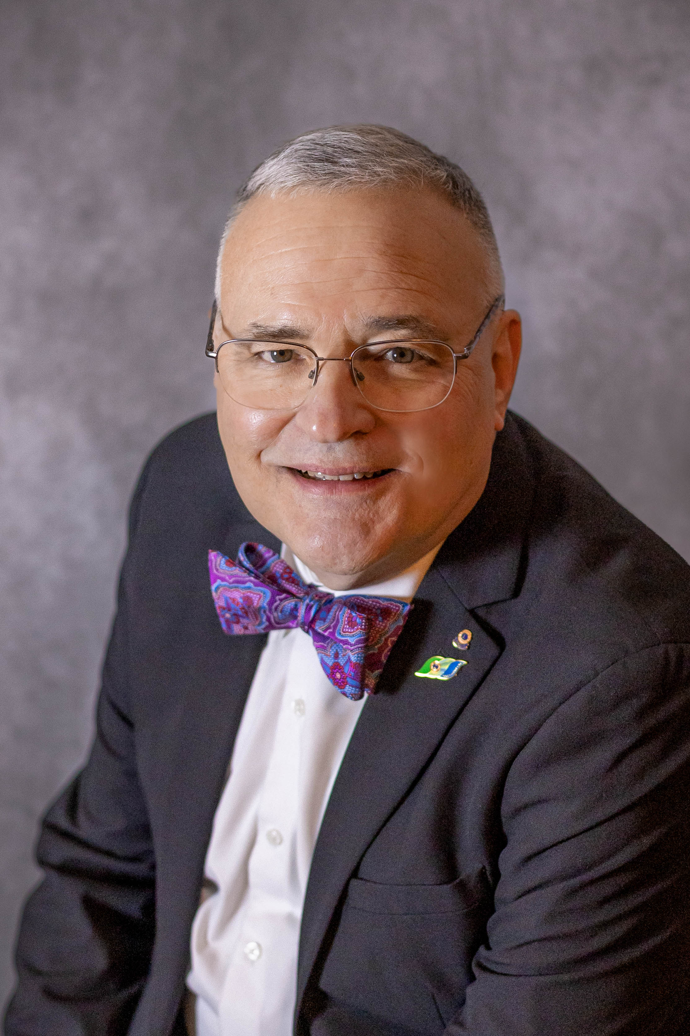
PDG Dave Wineman
Notes:
00:05 – 2:00 – 2:05
Special note… Please be ready at any part through this presentation to stand up quickly and tell your joy of being a Lion in one or two sentences ONLY!
-------------------------
My presentation starts here….
One of my joys of being a Lion is that it gives a chance for my wife and I to spend time with each other around other couples in a safe environment.
And I want to introduce past council chair Dave Hill, the Servant Leader Lion that brought that 40 year membership success to the state of Michigan.
The goal the forum committee asked me to accomplish was to show you how I became a success in business and relate that back to Lions.
Let’s start off by looking at a photo album that you may be able to identify with.

Slide 3
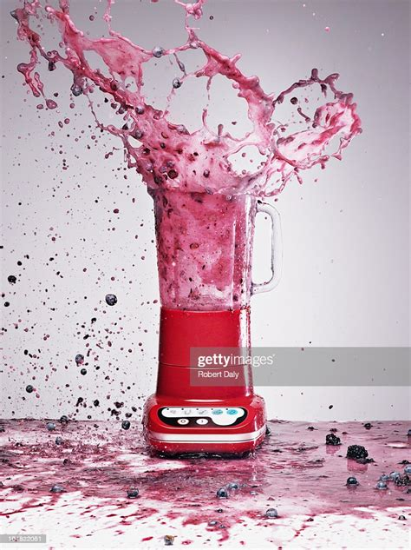
My Lions Photo
Notes:
2:05 - 00:10 – 2:15
Let’s peek into the future.. How is your district lookin’. Like this?

Slide 4
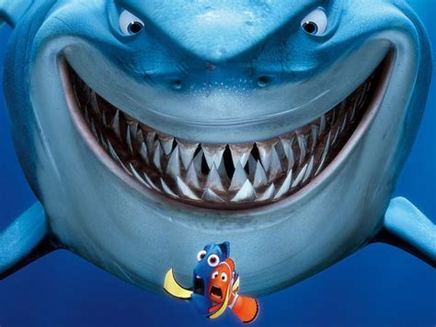
Notes:
2:15 - 00:05 – 2:20
Here is where we introduced that new service project idea. Look familiar?

Slide 5
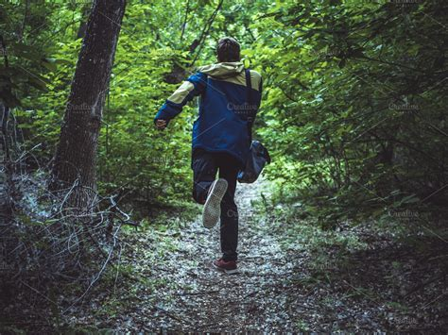
Notes:
2:20 – 00:05 – 2:25
Remember when we asked for nominations for the 2nd VDG.

Slide 6
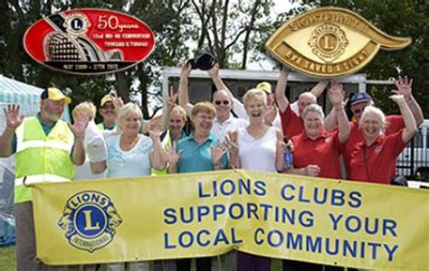
Notes:
2:25 - 00:05 – 2:30
Want your district to look like this?

Slide 7
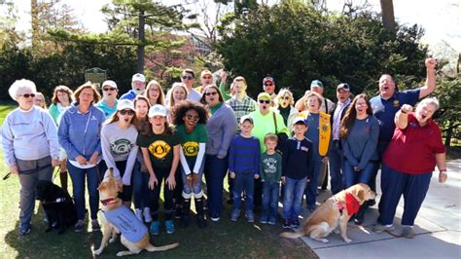
Notes:
2:30 - 00:05 – 2:35
Or like this?

Slide 8
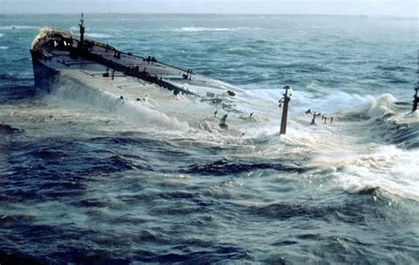
Notes:
2:35 – 0:15 – 2:50
So really captain… How is your ship doing? Like this?

Slide 9
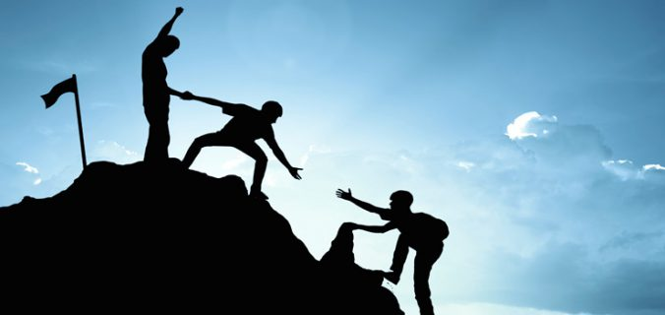
20’s & 80’s
What was different about the 20’s?
Commonalies of the 20’s?
Notes:
2:50 – 2:10 – 5:00
In a business we call the successful ones 20’s. That would be vereses the 80’s that will in all probability not make that critical 5 year mark. You may have figured out this is from the well-known concept called the preradio principle. 20 percent of the businesses last 5 years. 80 percent die within the first 5 years. Or, applied to a Lions club or district you might say that 20% of the districts will gain in membership and 80% will lose membership or stay status quo.
In business this is something that has been known for a long time. I never thought to apply this to the Lions world. As an Area Leader one of the places this became apparent was the district membership numbers. 20% of the districts could be expected to gain membership over the year. 80% no gain or a loss.
What made that happen? What uniqueness did those districts or clubs have?
One of the greatest commonalities is the leadership of the organization. Specifically, clubs or districts or multiple districts that had servant leaders, all had positive successes, be it membership, leadership or service.
Specifically, How did our Lions leaders lead Lions to success?

Slide 10
Someone tell me your joy of being a Lion!
Book #1
Notes:
5:00 - 2:00 – 7:00
But first, 1 Person tell me your joy of being a Lion! Remember 1 or 2 sentences only.
…..
Great! For your bravery and leadership, you get a token prize!

Slide 11
I Serve vs We Serve…
“The servant-leader is servant first. It begins with the natural feeling that one wants to serve, to serve first. Then conscious choice brings one to aspire to lead.”
-Robert Greenleaf, 1970
* Who is Robert Greenleaf?
* Managing for Results?
Notes:
– 1:30 –
Let me introduce you to a different kind of leadership. I like to call it I serve vs We Serve. You may have already heard of it. It is called Servant Leadership. Robert Greenleaf first popularized the phrase "servant leadership" in "The Servant as Leader", an essay published in 1970. Greenleaf proposed that servant leaders should serve first, make the needs of others their main priority, and find success and "power" in the growth of others. Some of the most productive and people successful companies on the globe, both large and small use a concept of Service Leadership. Let me also caution here. Many talk the words. Few walk the words.
Servant leadership is a leadership approach that puts serving others above all other priorities. Rather than managing for results, a servant leader focuses on creating an environment in which their team can thrive and get their highest-impact work done. In other words the leader is a servant first. The servant leader serves their team.

Slide 12
Notes:
– 0:30 –
Servant leadership is a leadership approach that puts serving others above all other priorities. Rather than managing for results, a servant leader focuses on creating an environment in which their team can thrive and get their highest-impact work done. The leader, rather than being autocratic, or a dictator if you will, is a servant to the team first and foremost. Just for emphasis how many time have you seen a district governor jump in and do the work while many of the others just stood by?

Slide 13
Notes:
6:05 – 2:05 – 8:10
The biggest difference between traditional and servant leaders is where their motivation lies. While traditional leaders care mostly about their own advancement, servant leaders want to see their whole team grow and succeed.
A traditional leader will measure success through results and prioritize shareholders over their customers and teammates. Or said a different way organizational success over service and membership. A servant leader puts their team first, service second, and organization last. While this may not be the fastest way to success, it can be more sustainable.
Finally, a traditional leader will use their authoritative rank to stand above others, which reflects in their communication style as well. Servant leaders view leadership as an opportunity to serve others, that would include our membership, so they’ll focus on listening and understanding their teammates versus speaking to and commanding things from them.
Regardless of what communication style you use, your team can benefit from clear communication and dedicated 1:1 time. Make sure you’re giving team members a space to build trust and be heard, no matter which leadership style you practice.
The one on the left is servant leadership and it has the greatest potential to build long and sustaining organiztions that show positive growth. The one on the right is a more traditional approach that features an autocratic behavior.
Both of these have utility. Servant leaders tend to build an organization that endures time, invites sucession of leadership, is sustainable, accomplishes much a better distribution of our human assets. Traditional or authorative leadership frequently struggles to get projects done, leaders vary widely from leader to leader, frequently lack vision, hit speed bumps between leaders, and struggle to get buy in.
Ask yourself some questions… Looking at Lions as a whole which model do we typically use? Which are we taught to use? What is my club or district like using the above description? Do we struggle getting new members? Do we have a steady flow of willing leaders wanting to step up? Ever hear anyone say, “We can’t find a 2nd Vice District Governor?”
I can tell you right now that new Lions without leaders that invest themselves in their success are our soon to be departed Lions. Without leaders that invest in the team Mission 1.5 is doomed or most likely unsustainable.

Slide 14
12 Core Competencies of a Servant Leader
Notes:
8:10 – 0:40 – 8:50
Here we are going to present 12 core competencies or characteristics of a servant leader. It is important to note when it comes to competencies or pillars of servant leadership some will claim that there are 7, some 10 or 12 core values that a servant leader possesses. The main point is back to the definition of the servant leader, that a servant leader should act as a servant, have a fire in their heart and make the success of their team a priority.

Slide 15
Self Awareness
Self-Awareness doesn’t prevent you from making mistakes.
It allows you to learn from them.
- Anonymous
Leaders don’t have to have all the answers.
Leaders have to show and grow confidence.
Delegation is important – but consider what to delegate.
Be humble.
Self Awareness is demonstrated through confidence, honesty and accepting feedback.
Notes:
– 2:15 –
Self awareness is knowing your passion. Knowing your emotions and your triggers. Understanding what your strengths and weaknesses are. Understanding how you respond to a particular situation. As a leader you are always on stage, whether you know it or not. Your teammates are continually analyzing you, your words, your mannerisms, your responses. Some questions to ask yourself: Does my body language match my words? Do my emotions match your teams needs?
As a leader do you show confidence? Are you channeling that confidence to where your team needs it the most.
Just because you are a leader doesn’t mean that you have to know all the answers. You are a leader because someone recognized that you have the qualities of a leader. You had a desire to be a leader, even if you didn’t show that aspect outwardly. Recognize this. Embrace it. Build on it.
When we build a team if we only include the same knowledge, likes and perspective that we already possess, we will have the same strengths, but also the same weaknesses. It is important to include a diverse set of people on our team. Actually, in Lions, it is important to have a team to begin with. And by the way, good conflict is a plus on a team. It builds a high functioning and team capable of growth.
We all know that delegation is important. Rather than the fear of losing control, a high functioning team is strengthened by delegation. Consider what to delegate and what not to delegate. Empower your team with delegation and recognition of diversity within the team. Above all, the key to this, remain humble.
Self awareness is demonstrated through confidence, honesty and accepting feedback.
-----------------------------------------------------------
Not part of presentation, but great filler….
5 Signs You May Lack Self-Awareness
1. Micromanage—find yourself always checking up on your team? You frequently ask for updates on each step. Step in to provide direction? Think to yourself-they cannot do it without me? You may suffer from micromanagement syndrome! STOP! If you are involved in this level of management, you may not believe in the team member. If you don’t believe the team member can do the job, why did you hire them or allow them to continue in their current role? SELF AWARENESS TIP-empower your team and let them fly. Be honest. Allow them to let you know if you are micromanaging without repercussions.
2. Defensive—Everyone gets defensive at some point. It is a normal human instinct. Defensiveness masks not taking responsibility. Denying bad outcomes. Placing blame on others or elsewhere. The “nothing is ever your fault” syndrome. Perhaps, you take constructive feedback personally. You defend your position or response with high emotions. SELF AWARENESS TIP-accept bad outcomes. Consider a recent fail. Identify the part you played on the outcome. Acknowledge your involvement to your leadership team. When you feel your defenses go up, ask yourself what are you masking.
3. Unable to Make a Decision—you are indecisive. It is difficult to make a decision and stick with it. You question your judgment. Have fear of making a bad decision. Develop analysis paralysis—running scenarios of the decision through your mind on a loop. SELF AWARENESS TIP-make a decision and stick with it. Don’t change your decision. If you see things going south, recalibrate but don’t deviate.
4. Passive Aggressive Actions—you avoid direct confrontation. You procrastinate. You redirect blame to others and cause them to question themselves. You give the silent treatment. You may insult others and call it constructive feedback. You may be described as stubborn. Passive aggressive behavioral will only result in resentment among your team. SELF AWARENESS TIP-Ask others how you treat them. Notice how you act when things don’t go your way or just as planned. Ask a friend to point out passive aggressive behavior.
5. Dress—dress for success. Dress like the boss! We are not going to a club or a date. Dress should be respectful. No low cut tops. Do the bend over test—if you can see your navel when you bend over, change your shirt! Unsure the meeting attire, then ask the host. One client may expect blue jeans on Friday, while others expect a suit. Know your audience and environment. Dress for the position you want to have and not the position you have. SELF AWARENESS TIP-look at your clothes. If they fit for a nightclub, they don’t fit for work! Hire a personal stylist if needed.
Know yourself. Hold yourself accountable. Rise to the next level. If unsure, take time to get to know yourself. Understand your passion, strengths, weaknesses and emotional triggers.

Slide 16
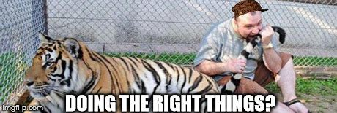
Stewardship
Management is doing the things right;
Leadership is doing the right things..
- Peter F Drucker
Careful and responsible management of something entrusted to one’s care.
Take responsibility.
Be accountable. First our own actions. Also, the Team.
Clear Obstacles & Bring Resources Together
Lead by example. No special privileges. How does it feel when others get special privileges?
Remember you need your team more than your team needs you!
Notes:
10:35 – 1:30 – 12:05
Stewardship is “the careful and responsible management of something entrusted to one’s care.” Stewardship is exemplified by taking responsibility and being accountable. First, we must be accountable for our own actions. Next, we must recognize that we are accountable for the team. Our job as a leader? To clear obstacles. To bring resources together. To encourage and strengthen the team. Incidentally, one of the best things we can do to accomplish this is leading by example. We follow the same rules as the rest of the team. No special privileges. How does it make you feel when some members of the team get special privileges? Angry? Frustrated? Keep a mirror handy.
Be willing to do the same work the rest of the team does.
Follow the rules of the team.
Care in interrupting or criticizing other team members.
Do not pick up un-necessary slack for the team.
Remember… You need your team, more than your team needs you. If our team fails, we fail. How many times in Lions do we comment or notice without much concern someone’s failure without any real concern? Did we ever consider the failure of the team? The service from the team? If the team failed, where were YOU?

Slide 17
Someone tell me your joy of being a Lion!
DC #1
Notes:
1 Person tell me your joy of being a Lion!

Slide 18
Recognition
Empowerment
Supportive
Partnership
Expectations
Consideration
Trust
Persuasion
Persuasion and Motivation travel hand in hand. The make us look bigger than we are.
Never through ill intention or manipulation.
Object is to get the team moving in one direction – the goal!
Good example is to persuade new Lions to get involved in service immediately.
Engage a group through the RESPECT model.
Notes:
12:05 – 1:10 – 13:15
Persuasion and motivation travel hand in hand. An effective leader has to lead people. But how does one move the unmovable? It should never be through ill intention or manipulation. That is selfish and condemned to failure. Motivation is like a magnifying glass. It makes things look bigger than they really are. It makes leaders appear more successful than we are. It aligns our team and gets the team pulling in the same direction. Knowing the team and trust are essential in leading a team and helping a team move (or motivate if you will) in the direction of a goal. Ever hear of Lions encouraging leaders to engage new members in service immediately? That builds motivation. By engaging in service, trust is built with team members, they see the good of their labors and get an all around feeling of success. How do you engage a group? Here is where the RESPECT model can come into play. Recognition, Empowerment, Supportive, Partnership, Expectations, Consideration and Trust. If you are a leader, one must persuade the team to go in the direction needed most by the organization. The leader has to have a fire in their heart before the team ever will. Start small and make things happen. Little successes lead to large successes.

Slide 19
Active Listening
Be a good listener. * No criticism condemning or complaining. * Keep your eyes focused on your speaker.
No playing with your cell phone. * No looking around for a better opportunity.
Watch the speakers body language and yours as well.
If we are not interested in people they are not going trust or be interested in us.
Notes:
13:15 – 1:00 – 14:15
Want to be a good listener? Be cheerful. Ask a safe question or two to engage the other person. Make eye contact and be genuinelhy interested in the other person’s conversation. Do not criticize condemn or complain. Keep eyes on the speaker, not playing with a phone, looking around the room for a better opportunity or figity. Watch the speakers body language and mind your own as well. Repeat the other person’s statements when clarification is needed. Be certain to ask questions. That is how we learn. Remember a leader needs to lead people. Our team has the knowledge and talents that we don’t have. If one is not interested in the people you are leading, then they are not going to trust or be interested in you.

Slide 20
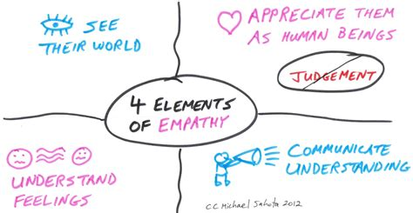
Empathy
Notes:
14:15 – 1:15 – 15:30
One of our greatest assets is empathy! Simply put empathy is our ability to understand someone else's feelings. If someone is angry, we must bear in mind they are angry at the situation and not at us. In the same way we can’t allow our overall organization decisions become personal. Developing our own emotional intelligence is an important skill. It keeps us looking professional. It also helps calm situations where emotions are running wild. Empathy is not a sign of weakness. It does not mean that we will give into every team concern or disagreement. Empathy helps us understand how our own decisions affect the team. Empathy helps develop trust with a team. The empathy we develop builds a trusting and safe team. Leverage empathy and understand everyone. The team will feel as that you care for them and are respected. The servant leader is a humble leader. They are a leader who focuses on empathy, meeting the teams needs, and putting the team first.

Slide 21
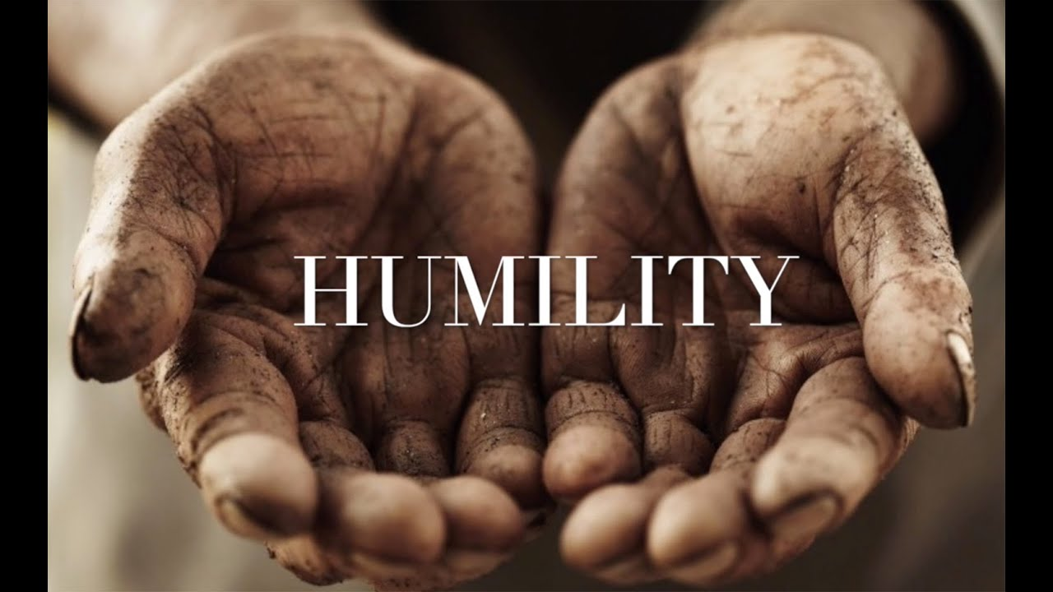
Acting With Humility
Notes:
15:30 – 1:00 – 16:30
Humility or humbleness is the acknowledgement of one’s own weaknesses. Face it if we knew everything and could do everything we would not gain by a team, much less a diverse team. We could accomplish everything ourselves. Why should we include others? The simple truth is that we need others to accomplish goals. Often words such as letting go, take the higher road, and putting others needs first are used to describe humility.
Leaders who lack humility often are autocratic, I’m the boss, irritable, impatient and use temper to lead. Often leaders who make quick hasty decisions, are prideful or command through fear.
One of the benefits of humility is that the leader gains the trust of the team. Humility leverages two other skills to a great degree, those being careful listening and empathy.

Slide 22
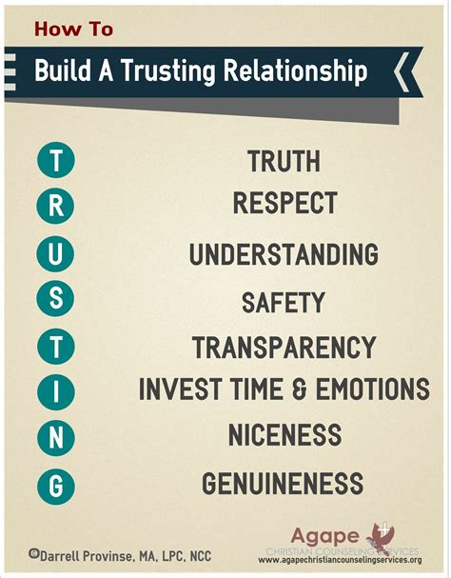
Culture of Trust
Notes:
16:30 – 2:00 – 18:30
Trust me! Probably the worst thing you can say to someone. My brother Charlie and I were in the steel business together. He always used the phrase “Trust Me” when he wanted something done which was questioned. Now in the business we worked with the State of Michigan in a early release program for work passers (prisoners for those not familiar with the term). One day one of them in gest hands him a tooled leather belt with the words “Trust Me” on it. The work passer then explained that the last time he trusted someone who said that was his attorney. Look where that landed him. Charlie rarely ever used the term again. He led many men to successful careers. To gain trust we must exhibit at least to the best of our ability, truthfulness, respect to the team and individuals of the team (even if you don’t like them), understanding (remember everyone has a different set of baggage), safety (it has to be a safe place for people), transparency (no hidden agendas), invest time and emotion (we have to invest in what we are doing by using our most precious asset – time and we need to be emotionally involved in a positive way), niceness (yes, we have to be nice, hope we all understand that concept), and genuine (no fake crying, laughing or false coverups). How do we get started with building trust? Read through the list, look in the mirror, and pick the two most challenging from the list.

Slide 23
Mentoring
Notes:
18:30 – 1:00 – 19:30
One of the most important things that we can do as a leader is build other leaders. In servant leadership mentoring gives back to the Lions organization. It provides continuity. Mentoring is the growth of two people – both you and those that have shared leadership and are coming up through the ranks. A few skills important when mentoring are open-mindedness, skillful listening, inquisitiveness, honesty and self awareness. Notice that many of these are already on the roadmap of a servant leader. Mentoring can work in the reverse direction as well. Reverse mentoring helps familiarize established leadership with diversities of more recent generations. Mentoring is a way of strengthening new leadership and guiding using previous experiences without necessarily defining the path beforehand.

Slide 24
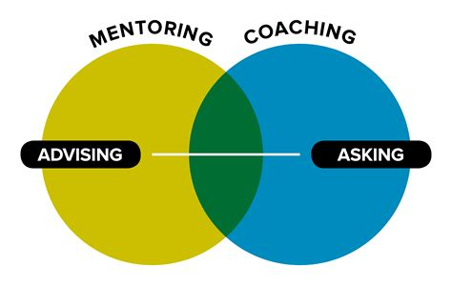
Coaching
Notes:
19:30 – 1:10 – 20:40
Coaching along with mentoring helps engage new leaders. Coaching differs in mentoring in that the coach brings a person along a pre-determined path to success. Typically this would imply that the person being coached was unfamiliar with the pathway verses exploring a viable pathway with a mentor. A typical scenario would be a team of Lions that are unfamiliar with a goal they are wanting to accomplish and an accomplished leader is brought in that is already successful with the target goal. That leader could coach the team of Lions. Coaching in servant leadership includes building SMART Goals – just like those developed in the GMA process Build a Vision and Build a Plan. Great coaching includes many of the open ended questions and processes of the GMA process. It differs from the GMA process in that it focuses on building leaders rather than a team goal.

Slide 25
Someone tell me your joy of being a Lion!
Book #2
Notes:
1 Person tell me your joy of being a Lion!

Slide 26
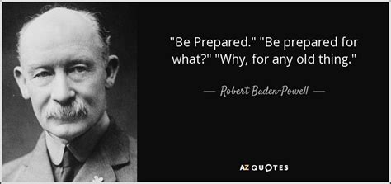
Foresight
Notes:
20:40 – 1:00 – 21:40
Anyone recognize this person? Foresight is the ability to utilize previous experiences to base current or upcoming decisions. The Boy Scouts call this “Be Prepared”. Foresight includes problem solving and identifying root causes of problems. A common technique used in foresight is root cause analysis. The common goal in foresight is to make the highest quality decisions. It helps to know what motivates your team and how the team will benefit. Foresight can then be applied to guide the team to achieve their goals. Cultivating the entire team in foresight will help reach goals faster, keep the team away from bear traps and gotchas, and improve the harmony of the team. By the way that is Lord Robert Braden Powell, the founder of Boy Scouts.

Slide 27
Vision
Notes:
21:40 – 1:00 – 22:40
Vision is timeless and should define the overall values, beliefs and goals. This could apply to a district, a club, a leader. With a vision we have that constant guiding star of where we need to head. We need to be able to communicate vision at any one moment. The GMA process includes a step titled Build a Vision. Having a vision in place before anything else is an extremely important step. It’s just my opinion, but most businesses that are successful have a clear Vision Statement. Most successful Lions do as well. Being able to communicate that vision is paramount to attaining any goals when leading volunteers or paid employees. Vision defines teams and their successes.

Slide 28
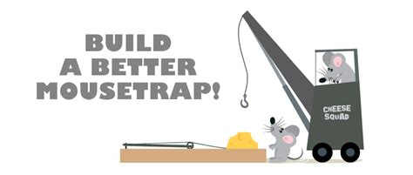
Continuous Development
WE need to continuously improve to keep up with our changing environment.
Demings Principles
Adaption to changing environment, conditions & values.
Adapting to the service we do. What is relevant? What is NOT relevant? What services are needed? What needs to be modified or eliminated?
Single reason why PDGs should not repeat as a DG?
Notes:
22:40 – 0:45 – 23:25
As time and environment change we as leaders have to be able to change with it. How many times have your heard someone comment that there was no need to change something. Sometimes that might be true. Many times however, we have to change to accommodate our changing environment, conditions and values. As leaders we need to be able to relate to those we lead. We need to understand how our team relates to the service that we do. What is relevant? What is not relevant? What services are needed? Which need modification or elimination?

Slide 29
Learn More…
Servant Leadership Roadmap: Master the 12 Core Competencies of Management Success with Leadership Qualities and Interpersonal Skills; Cara H Bramlett
The 21 Irrefutable Laws of Leadership - International Edition: Follow Them and People Will Follow You; John Maxwell
The Little Golden Book of Rules; Dale Carnegie
Robert K. Greenleaf Center for Servant Leadership
https://asana.com/resources/servant-leadership
https://deming.org/explore/fourteen-points/
Lions Learning Center, Servant Leadership
7 point Leader assessment, www.maxwellleader.com
Brian Kight, dailydiscipline.com
Notes:
23:25 – 1:00 – 24:25
If servant leadership appealed to you, here is where you can learn more…

Slide 30
Someone tell me your joy of being a Lion!
DC #2
Notes:
1 Person tell me your joy of being a Lion!

Slide 31
Pros
Fosters strong team culture: Servant leaders give ownership to their team members to increase their motivation, courage, and creativity.
Creates people-focused culture: Servant leaders establish a people-focused culture by fostering deep, trusting relationships with and between their teammates. This level of trust and connection allows teams to make decisions in the best interest of the organization and everyone involved.
Boosts team morale: A team that feels seen and valued by their leader tends to have stronger integrity and show a higher level of pride in their work. Servant leaders can boost team morale across teams and help develop future leaders by giving them opportunities to shine.
Promotes FUN
Notes:
22:40 – 0:45 – 23:25
Fosters strong team culture. To achieve 1.5 or GMA process goals it generally is going to take a strong team. Servant Leadership is all about building teams.
Servant leaders focus strongly on the team of people – our Lions! Exactly what is needed in our organization to not only build membership, but to retain it as well.
It keeps Lions Friendly, Upbeat and Nice – or FUN. It builds the morale of our team. Volunteers need to get some value out of their service. Paying dues “represents value”, but is not real value.

Slide 32
Cons
Formal authority may be lost: Because servant leaders get down on such a personal level with their teams, their formal authority is easily lost. This can become difficult when individuals take advantage of their leader’s transparency. It can also cause confusion when other leaders in the organization take a different approach.
Time intensive leadership style: Servant leadership requires a lot of time, energy, and experience. Servant leaders have to know their team members on a professional and personal level so they can support them to the fullest.
Team members may struggle with decision making: By giving their team members opportunities to prove themselves, servant leaders also risk overestimating and overburdening their teammates. Individuals that don’t have the courage or confidence for data-driven decision making on their own yet may feel discouraged and lost in a work environment that provides them with this much executive power.
Notes:
22:40 – 0:45 – 23:25
Lions depends on formal authority very heavily. There is not only a written formal authority, but there is a strong informal authority present. One of the best things a Lions desiring to be a servant leader can do is to focus on the two instant takeaways in their year as 2nd vice district governor. It might also be a good time to point out is that servant leaders still have the necessity to adapt to the situation and lead the club or district they are responsible for.
It takes considerable time to be people inclusive. It is also necessary to break down people barriers so that communication can happen regardless of time spent.
We live in a society where people are becoming more woke. In many cases they are encouraged not to make decisions or be confident. At one of my sessions I was told about a Coca-Cola add that encouraged people to be less confident, to hold back on making decisions. Wokism is the exact opposite of leadership. So the battle to build better organizations, be it member numbers, service numbers or safe clubs is getting more challenging.

Slide 33
Someone tell me your joy of being a Lion!
Book #3
Notes:
1 Person tell me your joy of being a Lion!

Slide 34
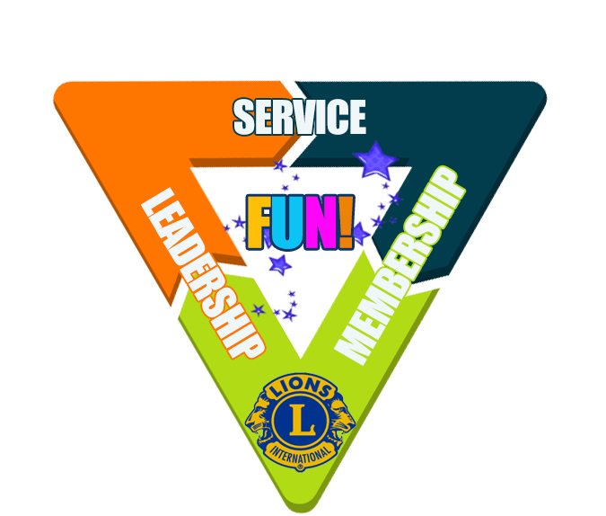
FUN!
Notes:
25:25 – 2:00 – 27:25
Let’s spend just a moment on some instant takeaways. Things that you can start thinking about and doing. Today!
One of the most important things that any leader can do is keep Lions FUN! Just what does that mean? FUN stands for friendly upbeat and nice. It does not mean that you have to jump around like some goofball or tell jokes. It does mean that you as a leader make Lions a place where people can come and enjoy the safety of the group – the pack. FUN is the very glue that holds our Service, Membership and Leadership together. It brings the people part of our organization together so that we can let down our hair if you will, but still do good for our communities. FUN is not by accident. Ever feel left out of the group? That’s no fun. Ever learn something from someone you thought was a total clutz? That is fun! Ever feel threatened by the intellect or getting made fun of by someone in the group? Not fun. Ever see the person in a group smile because they saved the day and the group recognized them? That’s fun.
People do not join Lions because they wanted to see us top 1.5 million members. They did not join because they wanted to be a district governor some day. They joined first because they needed to fill a social void in their lives. Lions needs to be a safe place to accomplish that. Keep Lions FUN!

Slide 35
Notes:
27:25 – 2:00 – 29:25
Being in business and being a recently past GAT Area Leader, I get to travel to a great number of places. There is one common denominator that screams out at me. From crossroads America to downtown Reno. You have seen it. <Give a Reno example….> If you are an empathetic person, you may have felt it. People more than ever need HOPE. How do we get started with HOPE? Very simply. Remember that the key to hope is this acronym. Helping Others (through) Positive Encouragement. So many people are in the “what’s in it for me” mode that they forget to build the environment around themselves. What they are left with is the dirty and the ugly part of man kind. Selfishness. Greed. Desire. The exact opposite of what a Lion is and what a Lion does. How do we clean the environment around us? By helping those around us with positivity and encouragement. Anything from a kind word to planting the confidence someone needs to get through another day. Know that EVERY person we come into contact with needs a positive word or act and some encouragement that they can do their very best to make a positive difference in those around them. It could be a pat on the back. It could be holding the door. It could be listening rather than talking. Lions. More than ever, our world needs HOPE.

Slide 36
Someone tell me your joy of being a Lion!
DC #3
Notes:
1 Person tell me your joy of being a Lion!

Slide 37
Strong enough to be weak
Successful enough to fail
Busy enough to make time
Wise enough to say “I don’t know”
Serious enough to laugh
Rich enough to be poor
Right enough to say “I’m wrong”
Compassionate enough to discipline
Mature enough to be childlike
Important enough to be last
Planned enough to be spontaneous
Controlled enough to be flexible
Free enough to endure captivity
Knowledgeable enough to ask questions
Loving enough to be angry
Great enough to be anonymous
Responsible enough to play
Assured enough to be rejected
Victorious enough to lose
Industrious enough to relax
Leading enough to serve
Poem by Brewer, as cited by Hansel, in Holy Sweat, Dallas Texas, Word, 1987. (p.29)
Notes:
29:25 – 1:00 – 30:25
Let me share a little poem about Servant Leadership with you….

Slide 38
Call To Action
Begin your Servant Leader Journey.
Look for the commonalities in words and action plans that you have heard in this forum and this process.
Place into action your servant leader skills and the GMA Process and Mission 1.5.
Sign the sheet at the back. Participate in a group discussion to further reinforce your journey.
Notes:
29:25 – 1:00 – 30:25
Begin your servant journey!
Questions?

Slide 39
Take Away & Questions?
PDG Dave Wineman
T: 989-225-3279
E: dw@abadata.com
Notes:
29:25 – 1:00 – 30:25
Key Take Away. As Lions we are part of the greatest service organization on the globe. We live and breathe service. My challenge to you as a leader.
Become a leader in Lions.
Serve your team in Lions. Give them the success that we would desire for ourselves.
I’m PDG Dave Wineman
Questions?

